Slide 1
“COVID-19 Now – Safe Practices to Minimize Spread” September 24th, 2021
This presentation is made possible:
In collaboration with the Hospital for Sick Children (SickKids); the Ministry of Children, Community and Social Services (MCCSS); and the Violence against Women Sector (VAW)
Notes:
Chitra

Slide 2
Topics today
Introduction – context worth noting
Questions you asked us – overview
Situation 1: School-based strategies against COVID-19
Situation 2: Shelter-based strategies against COVID-19
Situation 3: Children and COVID-19 now
Question and Answer period
Closing and Thank-you
Notes:
Chitra

Slide 3
Speakers and Facilitators – SickKids & VAW
Anu Wadhwa, MD, Staff Physician, Infectious Diseases Specialist [SickKids]
Laurie Streitenberger, RN, Senior Manager Infection Prevention and Control [SickKids]
Anna Cotic, RN, Occupational Hygienist [SickKids]
Alice Heisley, RN, Team Lead Covid-19 Testing Center [SickKids]
Ambuja Banerjee, MSc, VAW IPAC Champion [VAW Network]
Chitra Gnanasabesan, RRT, Senior Project Manager, Lead CSS [SickKids]
Notes:
Chitra

Slide 4
Introduction – context worth noting
The guidance on COVID-19 is evolving as new information becomes available about the virus and the variants, and as COVID-19 rates change
The information in this presentation reflects what is presently known given up-to-date evidence, and is current as of September 2021
The information presented is to support the questions you asked, and to help support staff
The speaker panel was hand-selected for their expertise, and specifically keeping you in mind
Notes:
Chitra

Slide 5
Questions you asked us – overview
There are two main areas of focus today:
Strategies to keep children minimally exposed to COVID-19 now.
Infection trend and disease severity with COVID-19 variants and children.
Question & Answer – last 10-15 mins of the session
Notes:
Chitra: Pass it to Ambuja to facilitate this slide and the rest of the presentation

Slide 6
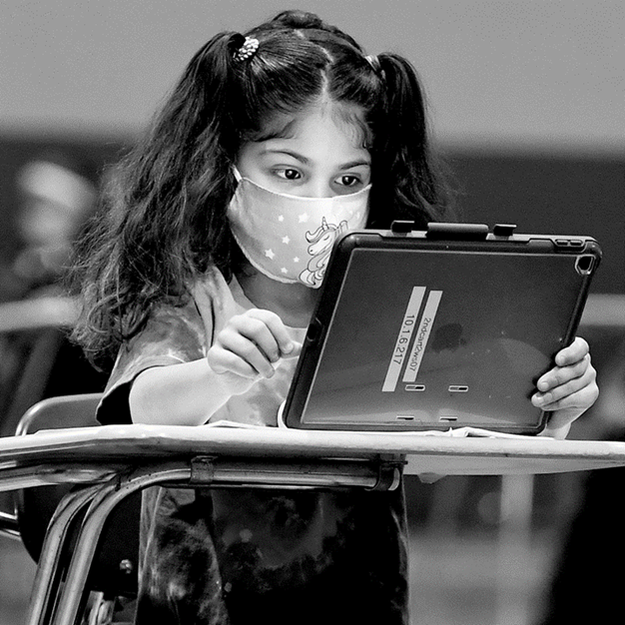
Situation 1: School-based strategies against COVID-19
How are schools keeping students safe?
What IPAC measures are used in the classrooms?
Notes:
Chitra: speaker
Ambuja: facilitator

Slide 7
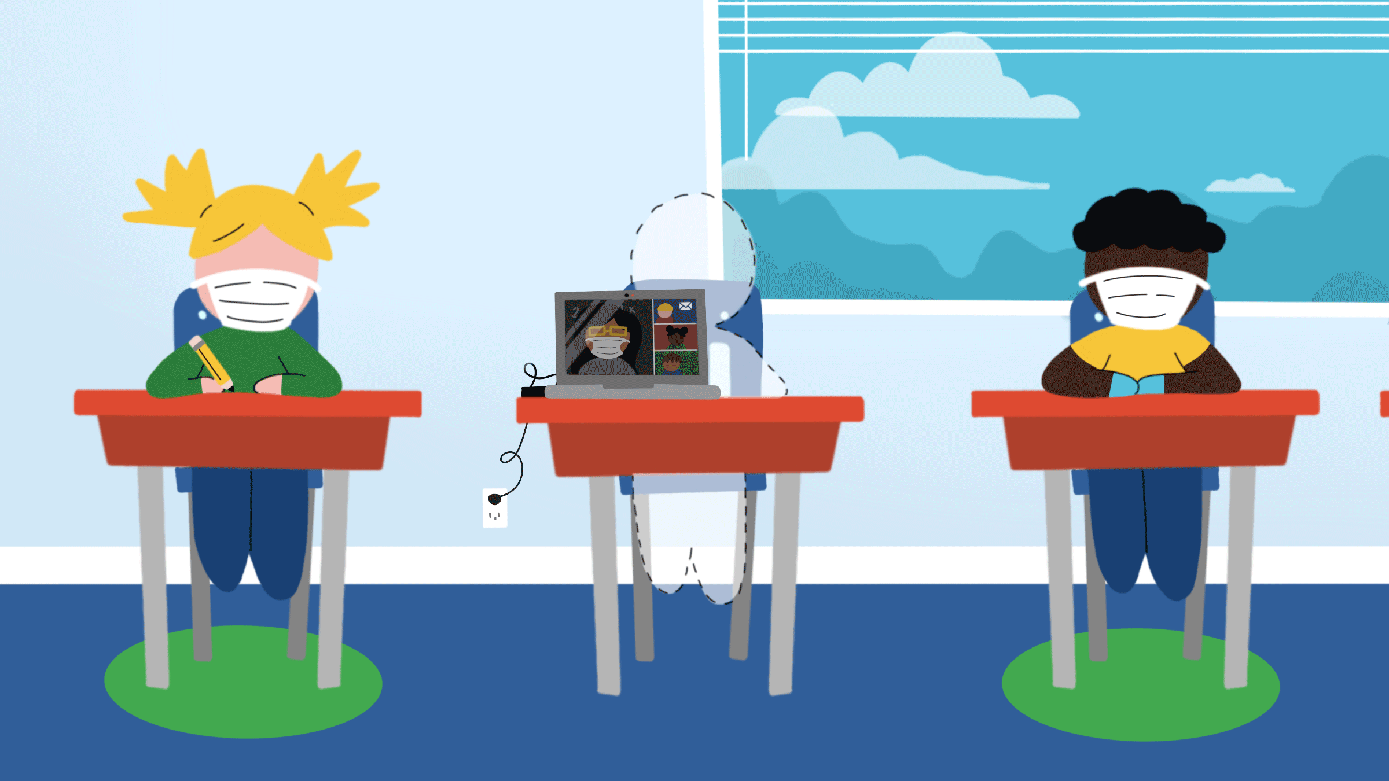
Situation 1 analysis
TDSB, TCDSB, TPH and MOE have developed school reopening guidelines
The guidance is recommended to all schools in Toronto
The guidance is based on current COVID-19 rates
With changing COVID-19 rates – updates/ changes to the guidance accordingly
Schools with high vaccine rates or neighborhoods with low COVID-19 rates – the guidance applies to all
The schools/ principals have developed safety policies using the guidelines based on their site-specific circumstances
Main objective: Keeping children safe in the school environment
https://www.ipsos.com/en/back-school-person-vs-remote-learning-challenges-facing-parents-teachers-and-governments
Notes:
Chitra: speaker

Slide 8
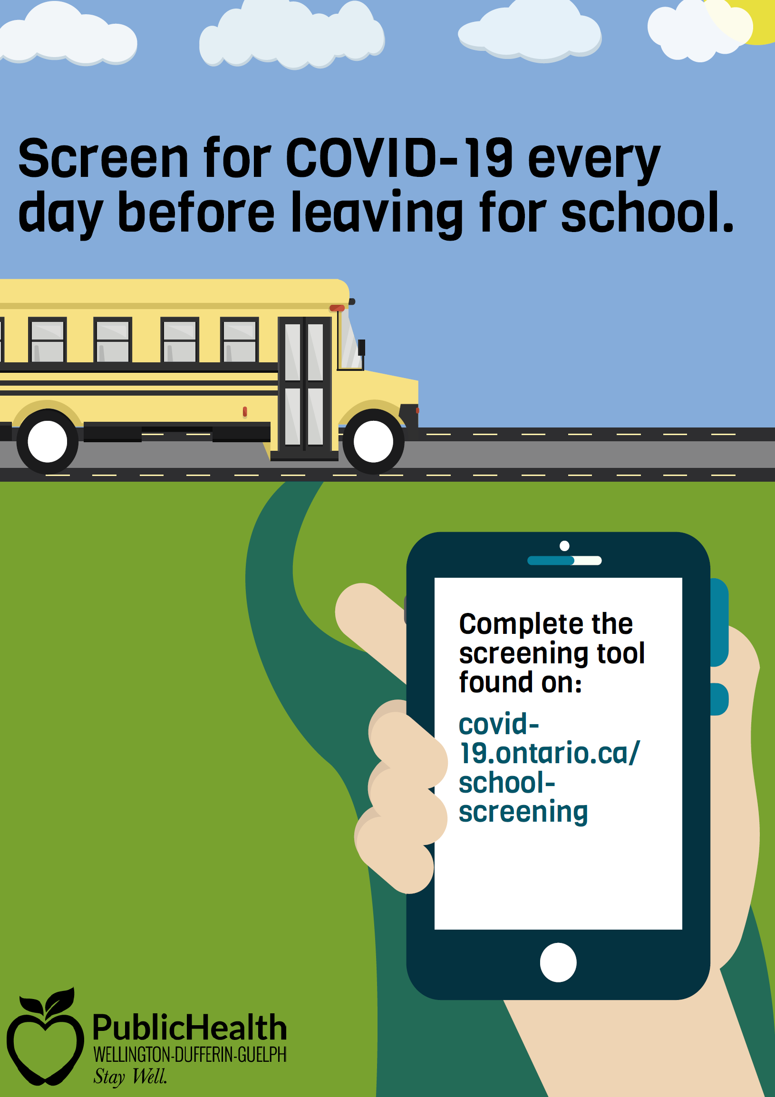
Situation 1 cont…
School Screening:
Use screening tools for symptoms daily (students, staff, visitors)
Student self-screening must pass and parent verification daily (signature)
Voluntary disclosure of vaccine status (helps with cohort dismissal planning)
Gradual Return:
Helps establish routines and student cohorting practices
Confidence in practicing health and safety protocols (IPAC)
Staggered school start, gradual return to extracurricular activities, modified class scheduling, etc. have helped with IPAC-focus
https://www.ugdsb.ca/jdh/2020/09/23/covid-screening-tool/
https://elem.hcdsb.org/blog/2020/08/28/gradual-return-to-school-for-elementary-students/
Notes:
Chitra: speaker

Slide 9
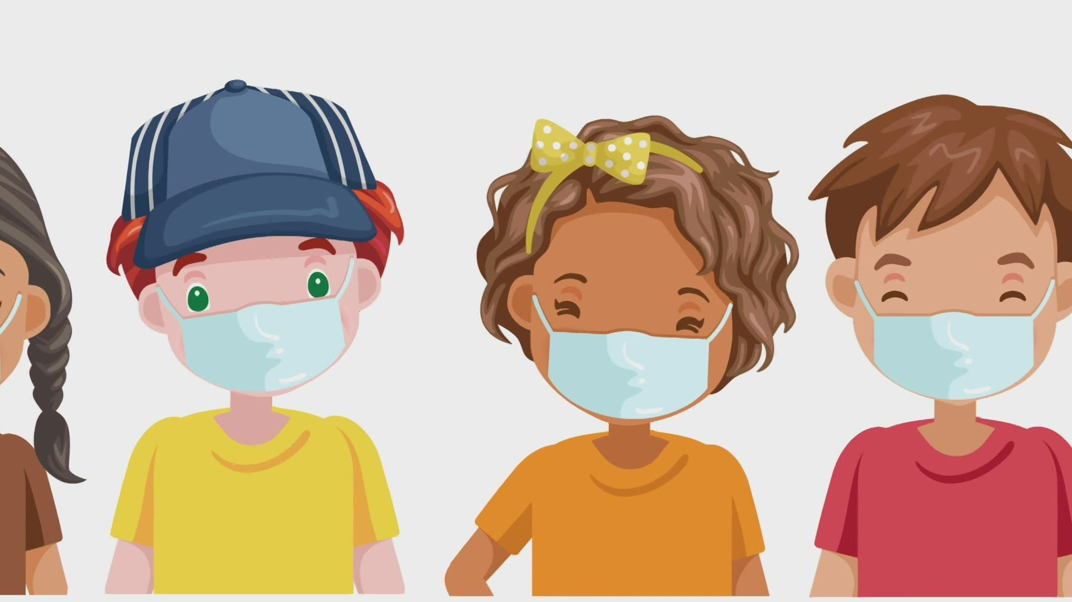
Situation 1 cont…
Indoor Masking Requirement:
Wearing properly fitted mask indoors/hallways/classrooms/school vehicles
Where it can be worn safely for indoor sports, based on physical activity (exemption swimming with >2m distancing)
Masking Exemption:
Eating indoors (staggered lunch, >2m distancing, labeled food/drinks, no sharing, limit conversation)
High/ low contact sports outdoors
When outside (>2m distancing between cohorts)
Sensory/ breathing issues (principal-approved)
Other Considerations for Staff:
Fit-tested N95 with AGMP (aerosol generating procedures)
Mask + eye protection (close student contact)
https://www.wfmynews2.com/article/news/local/2-wants-to-know/here-are-the-credible-facts-about-masks-in-school-safe-protection-help-hurt-students-teacher-north-carolina/83-5f9df179-eb8a-4db0-9ebe-081433fde7f2
Notes:
Chitra: speaker

Slide 10
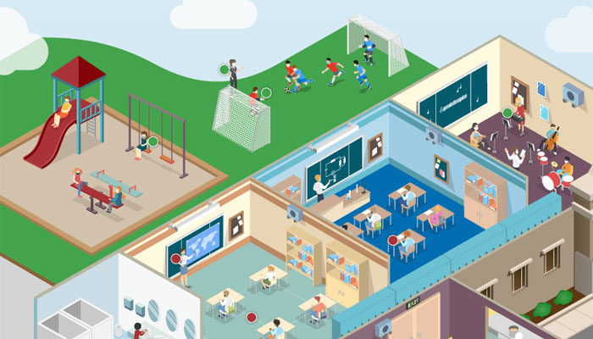
Situation 1 cont…
School Space Usage:
Cohorted class sizes as per space occupancy
Removing unnecessary furniture to allow for distancing
Student desks facing forward (no circles/groupings) with distancing
School arrival and departure procedures – maximize use of all entrances and exits to avoid crowds
Designated routes for students/ cohorts to and from classrooms
Signage/posters/visual cues to mark distancing and one-way traffic (floors, walls, furniture)
Hand sanitizers at entrances, exits, and in classrooms
Stagger scheduled breaks/ study periods to disable crowd forming
Secondary school modified semester cycles – e.g., 2 courses alternating to 2 different courses
https://schools.forhealth.org/
Notes:
Chitra: speaker

Slide 11
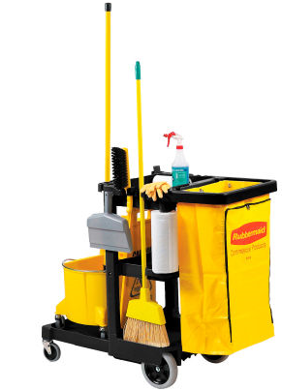
Situation 1 cont…
Environmental Cleaning:
The right cleaning and disinfection products with expiry dates (with DIN)
Frequency, timing, and high priority areas to clean and disinfect
Focus on high touch areas (twice/day at minimum recommended)
Continue to emphasize hand hygiene to decrease risk of infection to high touch surfaces
https://www.globalindustrial.ca/p/rubbermaid-janitor-cart-black-with-25-gallon-vinyl-bag?infoParam.campaignId=T9F&gclid=EAIaIQobChMIo5OjoZWW8wIVE67ICh2WAw60EAQYBCABEgIAyfD_BwE
Notes:
Chitra: speaker

Slide 12
Situation 1 cont…
Ventilation:
Dependant on age of the building
$550M invested in ventilation HVAC (2020-21) – repairs, retrofits, standalone HEPA filter units, window and exhaust upgrades to optimize air quality and ventilation
Proactive preventative maintenance program to service HVAC regularly
Higher priority given to ventilation related work orders
Change filters more frequently + use of efficient HEPA filters or higher MERV-13 rated air filters
HVAC system running time increased –
3 days continuously before start of school (after a break)
2 hours before school morning start
2 hours after school day ends
Open window + exhaust – older/ other buildings
https://www.rsi.edu/blog/hvacr/overview-of-hvac-in-different-work-settings/
Notes:
Chitra: speaker

Slide 13
Situation 2: Shelter-based strategies against COVID-19
What can the shelters do to support?
Children are going to a common area instead of going to their rooms to change clothes, wash hands, etc.
What additional precautions ensure minimum risk of COVID-19 transmission?
https://www.myhealthunit.ca/en/health-professionals-partners/resources/Group-home-and-shelter/2019-Revised-IPAC-Resource-for-Community-Shelters.pdf
Notes:
Laurie [& Anna]: speaker(s)
Ambuja: facilitator

Slide 14
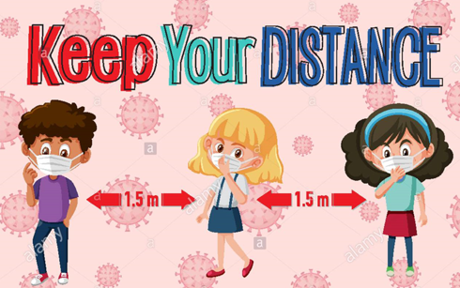
Situation 2 analysis
When children return from schools:
Clean their hands first – hand sanitizer will not remove visible soil. Wash hands at a sink.
Change their masks.
Maintain physical distance from others where possible.
No need to keep your shoes outside; do a risk assessment for your clothes (visible dirt, length of time worn, etc.).
Follow the practices already in place at the shelters – this should be sufficient to prevent transmission
https://www.alamy.com/keep-your-distance-or-social-distancing-sign-with-children-cartoon-characters-illustration-image368979164.html
Notes:
Laurie [& Anna]: speaker(s)

Slide 15
Situation 2 cont…
Safety measures in the shelters: COVID-19 Toolkit for congregate care settings to prevent transmission
Screening tools and processes to identify people with symptoms (staff, residents, visitors)
Policies on how to handle symptomatic people, and manage outbreaks
Physical distancing protocols (<2m distancing, room occupancy numbers posted, extra furniture removed, signage)
Universal masking, available supply of PPE
Notes:
Laurie [& Anna]: speaker(s)

Slide 16
Situation 2 cont…
Hand hygiene – access to hand sanitizers and soap and water
Vaccination and COVID-19 testing protocols, when appropriate
Disinfection of the environment
Safe use of spaces (occupancy limits, cohorting, staggering time, etc.)
Notes:
Laurie [& Anna]: speaker(s)

Slide 17
Situation 3: Children and COVID-19 now
What are the symptoms of COVID-19 in children?
Is the delta variant causing more severe disease in children?
Is the COVID-19 vaccine safe for children? What about myo/pericarditis? Any idea when there will be a vaccine for children under 12?
Are there statistics on school-age children contracting COVID-19 in Toronto/Ontario now?
https://kalliopekathryne.com/category/delta-variant/
Notes:
Anu: speaker
Ambuja: facilitator

Slide 18
What are the symptoms of COVID-19 in children?
Notes:
Anu: speaker

Slide 19
Symptoms of COVID-19 in children
Generally, the same as adults, but milder
Cough, cold, runny nose
Fever
Nausea, vomiting, diarrhea, stomach ache
Loss of taste and/or smell
Poor feeding in infants, loss of appetite
Headache, muscle aches
Notes:
Anu: speaker

Slide 20
Symptoms of COVID-19 in children
30% or more have no symptoms
Some only have one symptom
Vast majority have mild disease
Vast majority get better within 1-2 weeks with rest and symptom management at home
Small percentage get more serious symptoms and require admission to hospital (less than 1%, 0.68%)
Notes:
Anu: speaker

Slide 21
MIS-C
Rare complication after COVID-19 seen in children (0.03%)
Stands for: ‘multi-system inflammatory syndrome in children’
3-6 weeks after the initial infection
An overactive inflammatory response in the body
the body’s immune system has overreacted to the infection
this inflammation can affect several organs in the body
High fever, stomach ache, diarrhea, rash
Treated in hospital with medications that manage the inflammation
Most children recover completely with timely medical care
Notes:
Anu: speaker

Slide 22
Long COVID
Has been reported to occur in adults
Ongoing, persistent symptoms after recovering from the initial infection
Fatigue, sleep problems, joint pains, headaches, shortness of breath
Appears to occur in children as well, but less often than in adults
Early days – possibly affects 1% of children infected
Early days – but it appears as though children’s symptoms improve over time
Notes:
Anu: speaker

Slide 23
Is the delta variant causing more severe disease in children?
Notes:
Anu: speaker

Slide 24
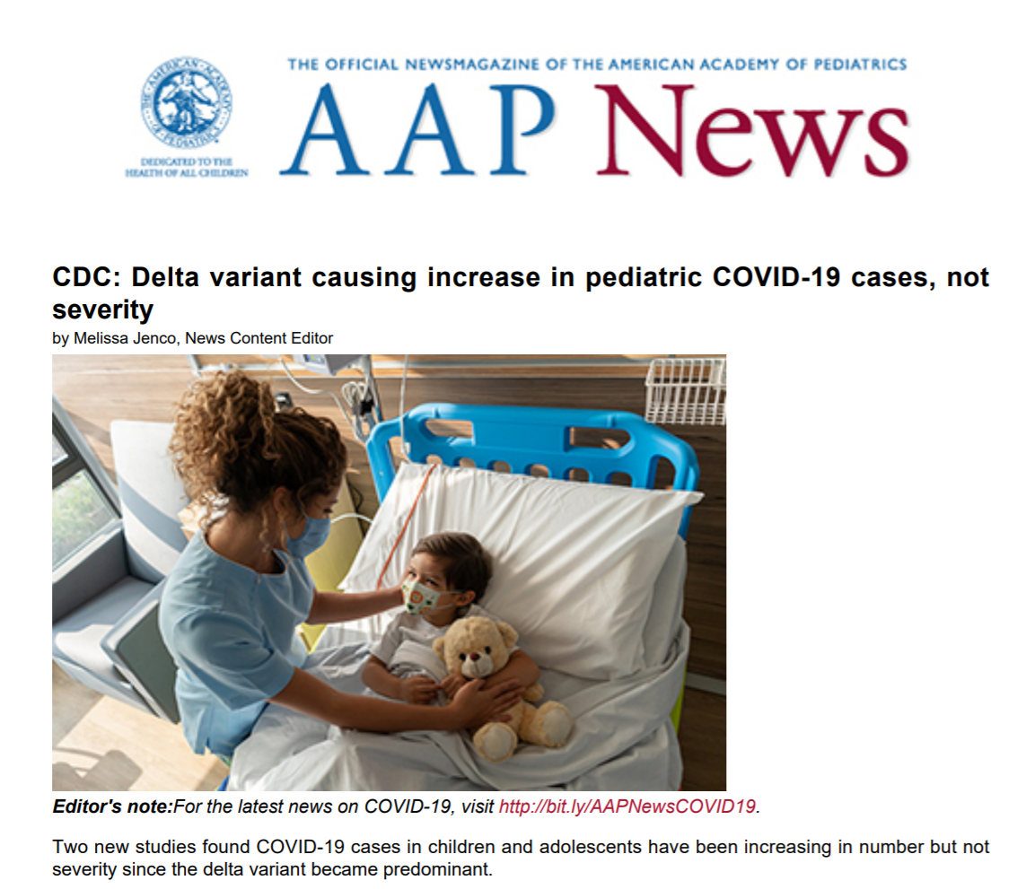

Slide 25
How is infection with the Delta variant different?
The delta variant of the virus that causes COVID-19 spreads more easily than previous variants, that is, it is more infectious or more transmissible
It appears that the delta variant may cause more severe disease in adults
Evidence so far has shown that it does not cause more severe disease in children
More children admitted to hospital in some states of the U.S. because overall more children infected (proportion of children requiring hospitalization is the same as with other variants)
Vaccine very effective in preventing severe disease from delta variant
Notes:
Anu: speaker

Slide 26
Notes:
Siegel DA, Reses HE, Cool AJ, et al. Trends in COVID-19 Cases, Emergency Department Visits, and Hospital Admissions Among Children and Adolescents Aged 0–17 Years — United States, August 2020–August 2021. MMWR Morb Mortal Wkly Rep 2021;70:1249–1254. DOI: http://dx.doi.org/10.15585/mmwr.mm7036e1external icon.

Slide 27
Summary: symptoms of COVID-19 in children
Vast majority asymptomatic or mild disease
Severe disease/hospitalization – RARE (0.68%)
MIS-C – RARE (0.03%)
Long COVID –RARE (1%?)
Delta variant is more infectious/spreads from person to person more easily, but does not appear to cause more severe disease in children
Notes:
Anu: speaker

Slide 28
COVID-19 Vaccine Safety and Children

Slide 29
COVID-19 vaccine safety and children
Millions of doses administered to children aged 12-17 years of age
Rare side effect of pericarditis or myocarditis seen (0.01%)
Inflammation of the heart muscle and/or the sac that surrounds the heart
Chest pain, chest discomfort, heart racing, lightheaded
Usually occurs 2-7days after the vaccine dose
Treated with rest and anti-inflammatory medication like ibuprofen/Advil, usually at home, rarely need hospitalization
Notes:
Anu: speaker

Slide 30
COVID-19 vaccine and myo-/pericarditis
Rare
Occurs in approximately 100 people per million vaccine doses given
Compare this with 450 people per million cases of COVID-19 infection
Risk is higher with actual infection
In Ontario 369 cases of myo/pericarditis reported after vaccination, 3 required admission to the ICU
Notes:
Anu: speaker

Slide 31
COVID-19 vaccines and children under 12 years
Currently not approved for use in children <12 years of age in Canada
Pfizer has recently completed a study of 2,268 children aged 5-11 years of age
Half of these children received the vaccine (two doses, 21 days apart)
Showed a very good antibody response
Numbers too low to comment on severe side effects
Notes:
Anu: speaker

Slide 32
Predicting the vaccine timeline
Possibly by around Jan 2022 – vaccine approved for 5-11 year-olds
Possibly by around Apr 2022- vaccine approved for 6 month to 5 year-olds

Slide 33
COVID-19 and schools

Slide 34
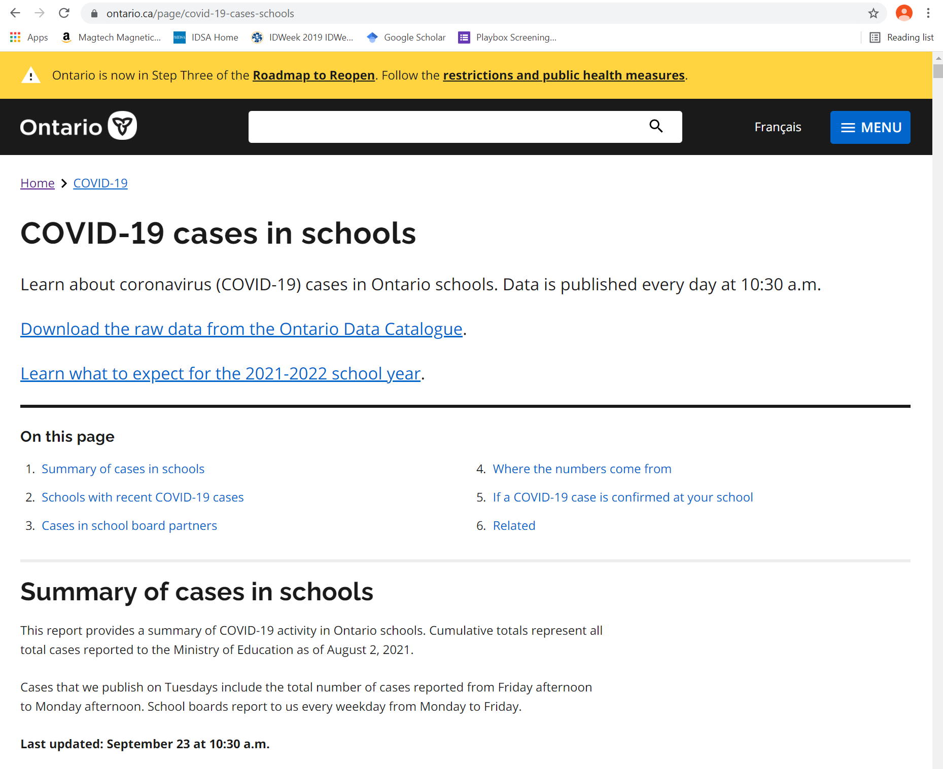

Slide 35
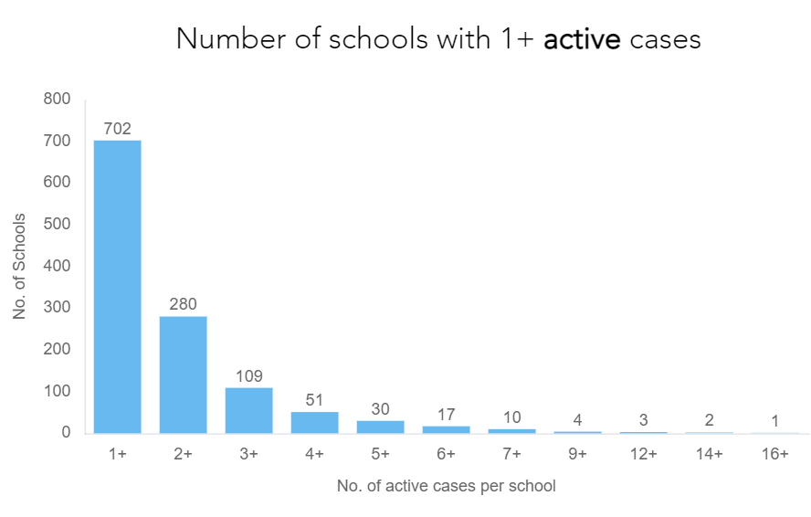

Slide 37
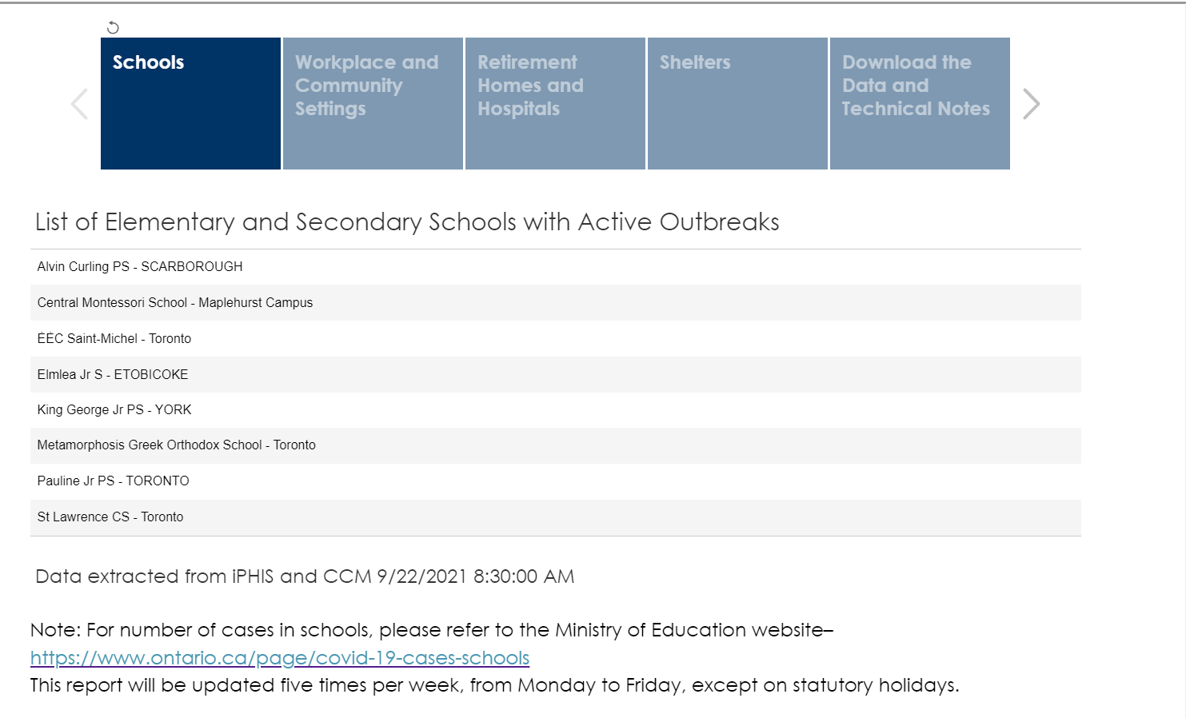

Slide 38
Summary points: COVID-19 and schools
Ontario.ca publicly reports the cases that are associated with schools
Currently approximately 1000 children attending schools in Ontario have been diagnosed with COVID-19 (out of 2 million children attending Ontario schools)
Came to school with COVID-19, but did they catch it from school?
Harder to say
Could reflect the amount of COVID that is in the community, caught it from someplace other than school (playdates, weddings, funerals, parties)
Toronto.ca reporting outbreaks in Toronto public and catholic schools – 10 at present
Parents should contact their school board and school for specific info about their school
Notes:
Anu: speaker

Slide 39
Summary points: COVID-19 and schools
Kids coming to school, some may have COVID-19, do the school measures work to stop it from spreading to other kids?
Ventilation, regular testing, screening, vaccination, masking, social distancing
Will get a better idea after 3-4 weeks of classes in session
Notes:
Anu: speaker

Slide 40
In context of low community transmission, and high community vaccination rates
children can safely return to school
if appropriate strategies are put into place.

Slide 41
Mitigation strategies
Physical distancing
Handwashing
Masks
Cohorting
Screening
Cleaning
Ventilation, Vaccination

Slide 42
The balance
Attending school will mean an increased risk of getting COVID-19 (most children get mild disease)
Not attending school carries other negative effects on children and the family
So for each family to consider the risk of attending vs. the risk of not attending and decide what works best for them
Notes:
Anu: speaker

Slide 43
Factors to consider in the balance
Community transmission rate
Age, vaccination status, and comorbidities of the child
Vulnerable contacts of the child?
The school’s plan

Slide 44
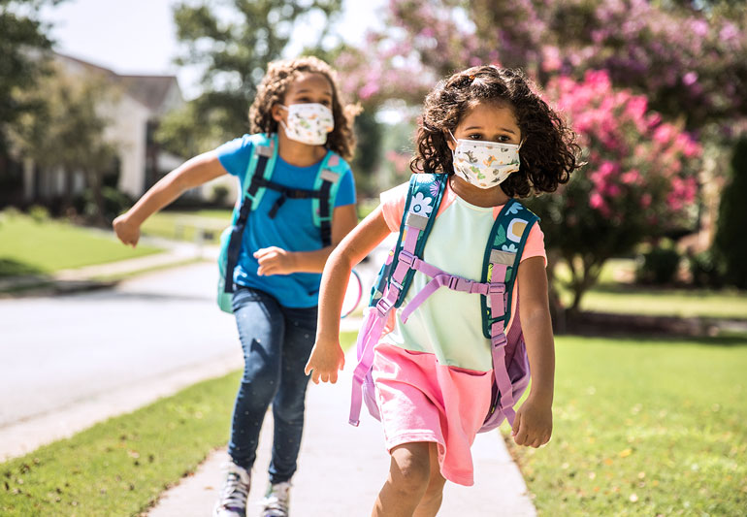
Thank-you
Notes:
Anu: speaker
Ambuja: facilitator

Slide 45
Question and Answer session
Image was from https://oliverands.com/community/blog/2013/11/questions-ask-me.html
Notes:
QUESTION DISTRIBUTION during Q&A: facilitated by Ambuja and Chitra

Slide 46
Closing and Thank-you
https://emilypost.com/advice/different-ways-to-say-thank-you
Notes:
Chitra and Ambuja

