Slide 1
“COVID-19 and You” December 2021
This presentation is made possible:
In collaboration with the Hospital for Sick Children (SickKids); the Ministry of Children, Community and Social Services (MCCSS); and the Violence against Women Sector (VAW)
Notes:
Chitra: speaker
Welcome everyone to our webinar series that SickKids, the Ministry of Children, Community and Social Services, and the Violence against Women Sector have collaborated on to bring you today’s presentation on COVID-19 and You.

Slide 2
Topics today
Introduction – context worth noting
Questions you asked us – overview
Masking and hand hygiene essentials
Cleaning and disinfection
COVID-19 delta variant and severity in children
COVID-19 vaccine safety in children, and readiness
Closing and Thank-you
Notes:
Chitra: speaker
The topics for today’s presentation are the following.
We’ll first start off with an introduction, and some context worth noting
Then we’ll go through the questions you asked
Followed by the topics for today, these are:
-masking and hand hygiene essentials
-cleaning and disinfection
-COVID-19 delta variant and severity in children
-COVID-19 vaccine safety in children, and readiness
We’ll then take your questions towards the last 10-15 minutes of the presentation
Please feel free to type your questions in the chat box, or ask them directly
Some questions will be interpreted from French to English and vice versa to benefit me – thank-you in advance for understanding

Slide 3
Introduction – context worth noting
The guidance on COVID-19 is evolving as new information becomes available about the virus and the variants, and as COVID-19 rates change
The information in this presentation reflects what is presently known given up-to-date evidence, and is current as of December 2021
The information presented is to support the questions you asked, and to help support staff
The speaker panel was hand-selected for their expertise, and specifically keeping you in mind
Notes:
Chitra: speaker
We hope to go over various questions that you have posed. As this PowerPoint provides solutions based on the Ministry guidance that exist presently, we would like to notify that these solutions may change as more research occurs, and as newer information becomes available about the COVID-19 virus and variants. Therefore the information presented today applies to what we are experiencing presently, and may require further updates at later dates of the pandemic.

Slide 4
Speakers and Facilitators – SickKids & VAW
Pierre-Philippe Piche-Renaud, MD, Staff Physician, Infectious Diseases Specialist [SickKids]
Sandra Isabel, MD, Staff Physician, Infectious Diseases Specialist [SickKids]
Chitra Gnanasabesan, RRT, Senior Project Manager, Lead CSS [SickKids]
Ambuja Banerjee, MSc, VAW IPAC Champion [VAW Network]
Notes:
Chitra: speaker
Pierre-Philippe Piche-Renaud – is a staff physician and infectious diseases specialist at SickKids
Sandra Isabel – is also a staff physician and infectious diseases specialist at SickKids
Ambuja Banerjee has co-planned this session with me. She has years of clinical research experience, and currently works with the violence against women sector as an Infection Prevention and Control Champion.
I am Chitra Gnanasabesan, co-facilitator with Ambuja, and the Senior Project Manager with SickKids, seconded since last year to community support strategy during the waves of Covid-19.
I want to thank our panel of speakers for making this presentation possible

Slide 5
Questions you asked us – overview
Masking and hand hygiene essentials
Cleaning and disinfection
PPE disposal process
The symptoms of COVID-19 in children
Severity of COVID-19 delta variant in children (myo/ pericarditis)
Safety of COVID-19 vaccine for children under age 12 (vaccine availability)
Statistics on school-age children contracting COVID-19 in Toronto/Ontario now
Question & Answer – last 10-15 mins of the session
Notes:
Chitra: speaker
We asked you to identify what matters the most to you and these are the questions you shared with us:
Masking and hand hygiene essentials
Cleaning and disinfection
PPE disposal process
The symptoms of COVID-19 in children
Severity of COVID-19 delta variant in children (myo/ pericarditis)
Safety of COVID-19 vaccine for children under age 12 (vaccine availability)
Statistics on school-age children contracting COVID-19 in Toronto/Ontario now
The first 3 questions, I will go through these with you, and the last 4 questions will be addressed by Pierre-Philippe and Sandra.
We also have a Q & A session the last 15 minutes, for you to ask questions or if you feel comfortable, please feel free to type them into the ‘Chat’ box.
I also like to say that I’ll try my best presenting in French, so thank-you in advance for your support.

Slide 6
Masking and Hand Hygiene Essentials
Masking
Hand hygiene
https://www.simplicityhr.com/safety-risk/safe-use-face-masks/
Notes:
Chitra: speaker
Let’s start with discussing safe masking habits, and followed by good hand hygiene practices

Slide 7
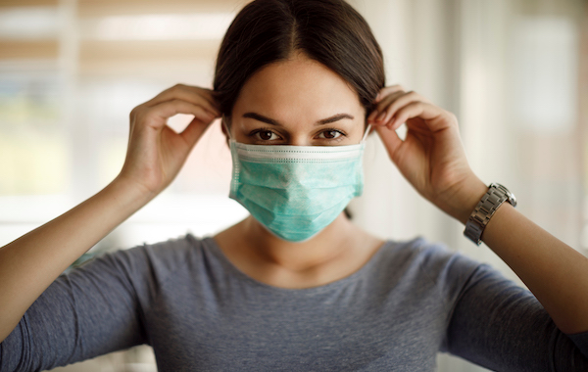
Masking
https://utswmed.org/medblog/covid19-mask-myths-realities/
Notes:
Chitra: speaker
First, we’ll start with masking practices

Slide 8
Masking dos and don’ts
Well-fitted mask [covers nose and mouth]
While wearing, don’t touch it
Don’t remove your mask when speaking with someone – if they can’t understand you, maintain at least 2m while your mask is off
Masking is required outdoors where physical distancing cannot be maintained
When not in use, a child's non-medical mask or face covering may be stored in a clean paper bag
Masks should be replaced when they become damp or visibly soiled
Dispose mask in a trash can with lid, and wash your hands
Masks are not recommended for children under the age of two – hand hygiene + distancing
Notes:
Chitra: speaker
It’s important to wear a well-fitted mask that covers the nose and the mouth to block the aerosols and prevent transmission
While wearing, don’t touch the mask as the outside of the mask is considered to be dirty as it’s come in contact with possible contaminants
Don’t remove your mask when speaking with someone even if they can’t hear or understand you because you can transmit infection if you pull down the mask. Minimally maintain at least 2 meters from someone if you have to remove your mask
Masking is required outdoors where physical distancing cannot be maintained
When not in use, a child's non-medical mask or face covering may be stored in a clean paper bag that is labeled with the child’s name
Masks should be replaced when they become damp or visibly soiled as they will no longer be effective and will not do their job well
Take off dirty or used mask by the strings, and dispose it in a trash can with lid, and afterwards make sure to wash your hands
Masks are not recommended for children under the age of two because
it’ll be harder for them to breathe through as their airways are smaller,
it could pose a risk of suffocation and they may not be able to take it off quickly as they’re small,
Small parts of the mask may become chocking hazards
older toddlers may try to take the mask off thereby touching the mask too often so it’ll become contaminated and inefficient because it’s not on their face
Masks and visors are typically not made for smaller faces
Best ways to manage are frequent hand hygiene and distancing at least 2 meters from someone else

Slide 9
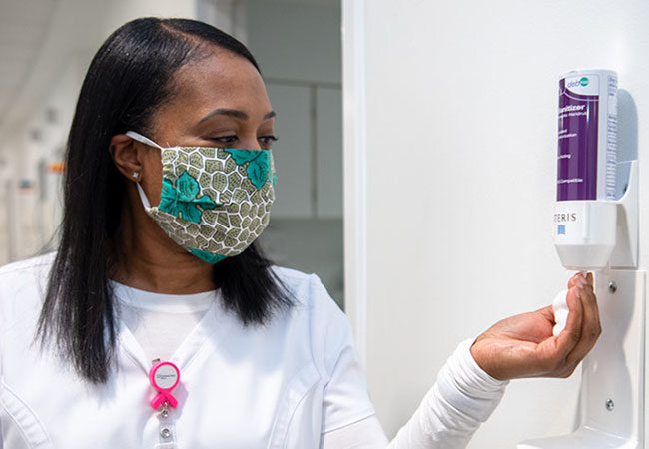
Hand hygiene
https://consultqd.clevelandclinic.org/face-masks-reduce-risk-of-covid-19-infection-but-should-be-used-with-other-interventions/
Notes:
Chitra: speaker
Next, we’ll discuss good hand hygiene practices

Slide 10
Bacteria on hands
Everyone has two categories of microorganisms on their skin, transient and resident bacteria.
Transient bacteria
Present on upper layers of the skin and obtained from direct contact with contaminated objects/ environment
Easily passed on to others – frequent cause of infections
Effective hand hygiene kills/ removes transient bacteria on the skin
Resident bacteria
Found in the deeper layers of skin and more resistant to removal
Do not generally cause infections – beneficial to maintaining healthy skin
Notes:
Chitra: speaker
Everyone has two categories of microorganisms on their skin, transient and resident bacteria on their hands.
Transient bacteria colonize the upper layers of the skin and are acquired from direct contact with children, staff, contaminated objects and/or the environment. Transient bacteria may also be easily passed on to others or from objects in the environment (also called fomites) and are a frequent cause of infections (WHO, 2009). Effective hand hygiene kills or removes transient bacteria on the skin and reduces the risk of transmitting communicable diseases to others.
Resident bacteria are found in the deeper layers of skin and are more resistant to removal. These bacteria do not generally cause infections and can be beneficial to maintaining healthy skin.

Slide 11
Types of hand hygiene
Hand sanitizing with alcohol-based hand rubs (ABHR) containing 70% to 90% alcohol
Preferred method when hands are not visibly soiled
Takes less time than traditional hand washing
People generally don’t wash hands properly – use of ABHR is more effective
Hand wash thoroughly with soap and water after many uses of ABHR
Hand washing with soap and running water
Must be done when hands are visibly soiled
Organic material on the hands reduces the effectiveness of ABHR
Mechanical action of washing, rinsing, and drying – removes transient bacteria
If hands are visibly soiled and running water is not available (e.g., field trips) – moistened towelette to remove the visible soil, followed by ABHR
Notes:
Chitra: speaker
There are 2 types of hand hygiene methods
Hand sanitizing with alcohol-based hand rubs (ABHR) containing 70% to 90% alcohol is the preferred method when hands are not visibly soiled. Using easily accessible ABHR in most settings takes less time than traditional hand washing especially when tasks being performed are fast paced. Also, as people generally do not wash hands adequately, the use of ABHR is more effective than washing the hands with soap and water when hands are not visibly soiled. It is recommended that a thorough and effective hand wash with soap and water be done after several uses of ABHR.
Hand washing with soap and running water must be performed when hands are visibly soiled. The presence of organic material on the hands can significantly reduce the effectiveness of ABHR. The mechanical action of washing, rinsing, and drying is the most important contributor to the removal of transient bacteria. If hands are visibly soiled and running water is not available (e.g., field trips), use a moistened towelette to remove the visible soil, followed by ABHR.

Slide 12
Hand hygiene practices
Keep nails short and clean
Remove rings and bracelets
Do not wear artificial nails
Remove chipped nail polish
Make sure that sleeves are pushed up and do not get wet
It is important that skin on hands remain intact to reduce the spread of organisms
To clean hands properly:
Rub all parts of the hands with an alcohol-based hand rub or soap and running water
Pay special attention to fingertips, between fingers, back of hands, and base of the thumbs
Clean hands for a minimum of 15 seconds
Sing the ‘happy birthday’ song twice to keep the count
Dry hands thoroughly
Apply water-based lotion to hands frequently
Notes:
Chitra: speaker
It is important that skin on hands remain intact to reduce the spread of organisms.
To clean hands properly:
Rub all parts of the hands with an alcohol-based hand rub or soap and running water.
Pay special attention to fingertips, between fingers, back of hands, and base of the thumbs.
Additionally, it’s important to:
Keep nails short and clean
Remove rings and bracelets
Do not wear artificial nails
Remove chipped nail polish
Make sure that sleeves are pushed up and do not get wet
And also to:
Clean hands for a minimum of 15 seconds
Sing the ‘happy birthday’ song twice to keep the count
Dry hands thoroughly
Apply water-based lotion to hands frequently

Slide 13
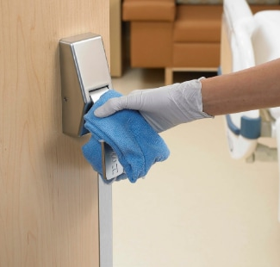
Cleaning and Disinfection
Cleaning, sanitizing, and disinfecting
Environmental cleaning
https://www.ecolab.com/articles/2020/04/the-importance-of-environmental-services-during-a-pandemic
Notes:
Chitra: speaker
Let’s now switch gears and speak about the differences between cleaning, sanitizing, and disinfecting.
Then focus on cleaning agents and effective practices to disinfect our environment while doing this safely.

Slide 14
Cleaning, sanitizing, and disinfecting
Cleaning:
Removes dirt from surfaces
Works by using soap/ detergent
Water and friction to physically remove dirt
Cleaning before disinfecting
Sanitizing:
Reduces germs on surfaces to levels considered safe for public health
Disinfecting:
Destroys almost all infectious germs
No effect when there is dirt, soil, or dust on the surface to be disinfected
Use in high-risk and high-touch areas, or in case of infectious disease
EPA registered
Notes:
Chitra: speaker
Cleaning: Removes germs, dirt, and impurities from surfaces or objects. Works by using soap/detergent, water and friction to physically remove dirt and germs from surfaces. Cleaning before disinfecting reduces spreading infection more than disinfecting alone.
Sanitizing: Reduces germs on surfaces to levels considered safe for public health.
Disinfecting: Destroys almost all infectious germs, when used as the label directs on a surface. No effect when there is dirt, soil, or dust on the surface to be disinfected. Should be used where required by law, in high-risk and high-touch areas, or in case of infectious disease. Products must be EPA (Environmental Protection Agency) registered.

Slide 15
What should be considered?
-Remove dirt before applying disinfectant
-Surface type
-Cover all surface area
-Contact time
-High-touch surfaces – priority disinfection
Door/ window handles
Kitchen/ food preparation areas
Counter tops
Bathroom surfaces
Toilets and taps
Touchscreen personal devices, computer keyboards, and workspaces
Notes:
Chitra: speaker
So, what should be considered when planning to disinfect?
First, the high-touch surfaces should be considered a priority. In non-health care settings, areas identified as priority for disinfection are – door and window handles, kitchen and food preparation areas, counter tops, bathroom surfaces, toilets and taps, touchscreen personal devices, personal computer keyboards, and work surfaces. The presence of dirt for example, inactivates the disinfectant, and manual cleaning to physically remove all matter is important before applying a disinfectant. This is less effective on porous surfaces and disinfectant should adequately cover surfaces allowing the required contact time to inactivate pathogens.

Slide 16
Disinfectants and practices
In non-health care settings – surface disinfection:
Follow the recommendations of the shelter sites, and manufacturer label
Bleach or chlorine based [recommended concentration]
Alcohol [70-90%]
Clean surface first to remove dirt
Clean from least to most soiled
Wipe with cloth [avoid spraying]
DIN and store safely
Notes:
Chitra: speaker
In non-health care settings, follow the recommendations of the shelter sites and manufacturer label for surface disinfection. Generally, sodium hypochlorite (bleach / chlorine) may be used at a recommended concentration of 0.1% or 1,000ppm (1 part of 5% strength household bleach to 49 parts of water). Alcohol at 70-90% can also be used for surface disinfection. Surfaces must be cleaned with water and soap or a detergent first to remove dirt, followed by disinfection. Cleaning should always start from the least soiled (cleanest) area to the most soiled (dirtiest) area in order to not spread the dirty to areas that are less soiled.
In indoor spaces, routine application of disinfectants to surfaces via spraying is not recommended for COVID-19. If disinfectants are to be applied, these should be via a cloth or wipe which is soaked in the disinfectant.
All disinfectant solutions should be stored in opaque containers, in a well-ventilated, covered area that is not exposed to direct sunlight and ideally should be freshly prepared every day. They should have a DIN (Drug Identification Number).

Slide 17
What are the symptoms of COVID-19 in children?
Notes:
Anu: speaker

Slide 18
Symptoms of COVID-19 in children
Generally, the same as adults, but milder
Cough, cold, runny nose
Fever
Nausea, vomiting, diarrhea, stomach ache
Loss of taste and/or smell
Poor feeding in infants, loss of appetite
Headache, muscle aches

Slide 19
Symptoms of COVID-19 in children
30% or more have no symptoms
Some only have one symptom
Vast majority have mild disease
Vast majority get better within 1-2 weeks with rest and symptom management at home
Small percentage get more serious symptoms and require admission to hospital (less than 1%, 0.68%)

Slide 20
MIS-C
Rare complication after COVID-19 seen in children (0.03%)
Stands for: ‘multi-system inflammatory syndrome in children’
3-6 weeks after the initial infection
An overactive inflammatory response in the body
the body’s immune system has overreacted to the infection
this inflammation can affect several organs in the body
High fever, stomach ache, diarrhea, rash
Treated in hospital with medications that manage the inflammation
Most children recover completely with timely medical care

Slide 21
Long COVID
Has been reported to occur in adults
Ongoing, persistent symptoms after recovering from the initial infection
Fatigue, sleep problems, joint pains, headaches, shortness of breath
Appears to occur in children as well, but less often than in adults
Early days – possibly affects 1% of children infected
Early days – but it appears as though children’s symptoms improve over time

Slide 22
Is the delta variant causing more severe disease in children?

Slide 23
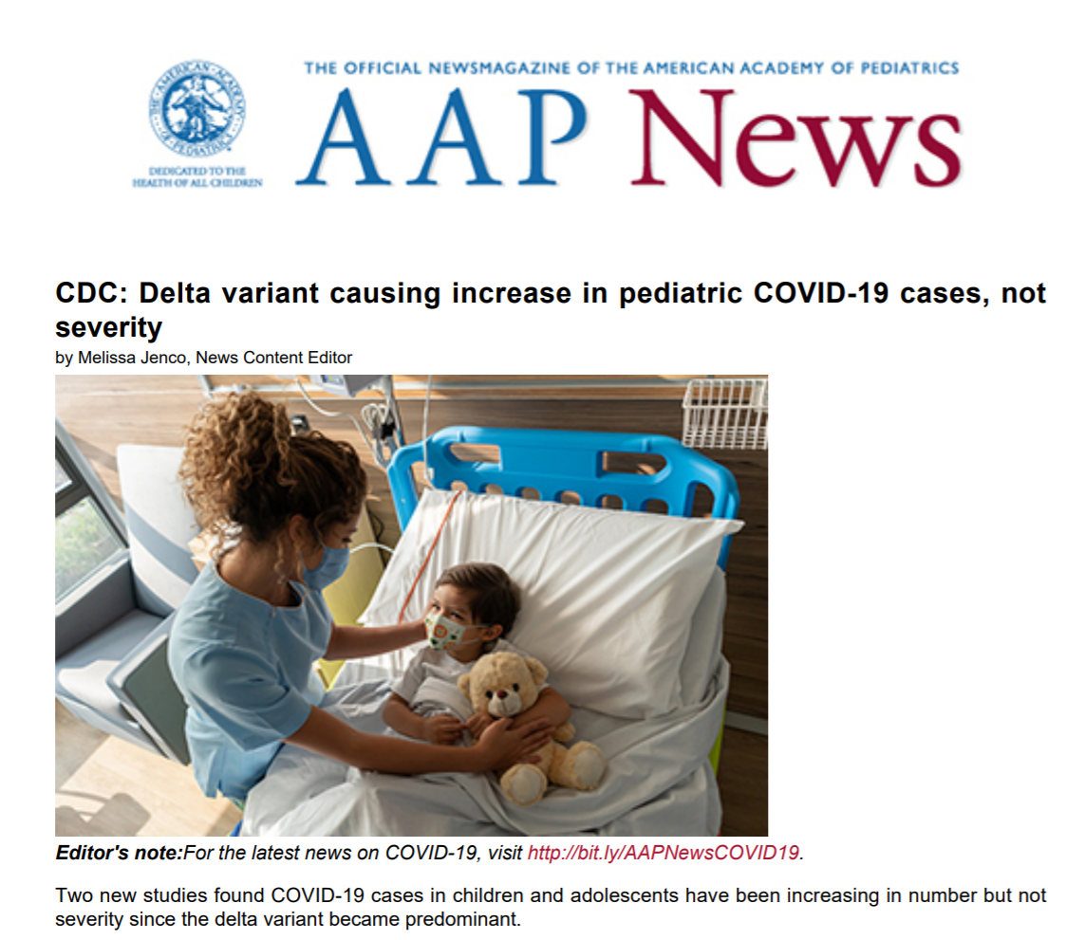
Notes:
The good news is that there are two recent studies from the U.S. experience that are showing us that is probably doesn’t cause more severe disease in children.

Slide 24
How is infection with the Delta variant different?
The delta variant of the virus that causes COVID-19 spreads more easily than previous variants, that is, it is more infectious or more transmissible
It appears that the delta variant may cause more severe disease in adults
Evidence so far has shown that it does not cause more severe disease in children
More children admitted to hospital in some states of the U.S. because overall more children infected (proportion of children requiring hospitalization is the same as with other variants)
Vaccine very effective in preventing severe disease from delta variant

Slide 25
Notes:
Siegel DA, Reses HE, Cool AJ, et al. Trends in COVID-19 Cases, Emergency Department Visits, and Hospital Admissions Among Children and Adolescents Aged 0–17 Years — United States, August 2020–August 2021. MMWR Morb Mortal Wkly Rep 2021;70:1249–1254. DOI: http://dx.doi.org/10.15585/mmwr.mm7036e1external icon.

Slide 26
Summary: symptoms of COVID-19 in children
Vast majority asymptomatic or mild disease
Severe disease/hospitalization – RARE (0.68%)
MIS-C – RARE (0.03%)
Long COVID –RARE (1%?)
Delta variant is more infectious/spreads from person to person more easily, but does not appear to cause more severe disease in children

Slide 27
COVID-19 Vaccine Safety and Children
Notes:
Is the COVID-19 vaccine safe for children?

Slide 28
COVID-19 vaccine safety and children
Millions of doses administered to children aged 12-17 years of age
Rare side effect of pericarditis or myocarditis seen (0.01%)
Inflammation of the heart muscle and/or the sac that surrounds the heart
Chest pain, chest discomfort, heart racing, lightheaded
Usually occurs 2-7days after the vaccine dose
Treated with rest and anti-inflammatory medication like ibuprofen/Advil, usually at home, rarely need hospitalization

Slide 29
COVID-19 vaccine and myo-/pericarditis
Rare
Occurs in approximately 100 people per million vaccine doses given
Compare this with 450 people per million cases of COVID-19 infection
Risk is higher with actual infection
In Ontario 369 cases of myo/pericarditis reported after vaccination, 3 required admission to the ICU

Slide 30
COVID-19 vaccines and children under 12 years
Currently not approved for use in children <12 years of age in Canada
Pfizer has recently completed a study of 2,268 children aged 5-11 years of age
Half of these children received the vaccine (two doses, 21 days apart)
Showed a very good antibody response
Numbers too low to comment on severe side effects

Slide 31
Predicting the vaccine timeline
Possibly by around Jan 2022 – vaccine approved for 5-11 year-olds
Possibly by around Apr 2022- vaccine approved for 6 month to 5 year-olds

Slide 32
COVID-19 and schools

Slide 33
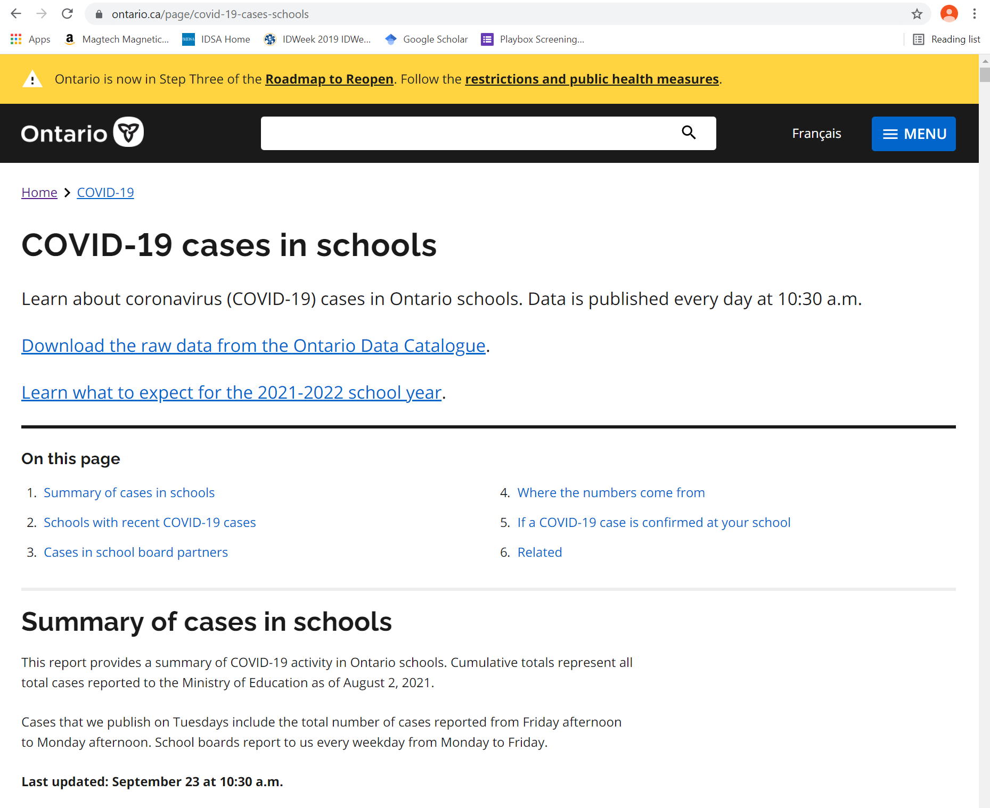
Notes:
Positive cases in schools in Ontario is publicly reported (Ontario public health website – Ontario.ca)
As of yesterday - 702 schools out of 4844 with a reported case
Zero schools closed

Slide 34
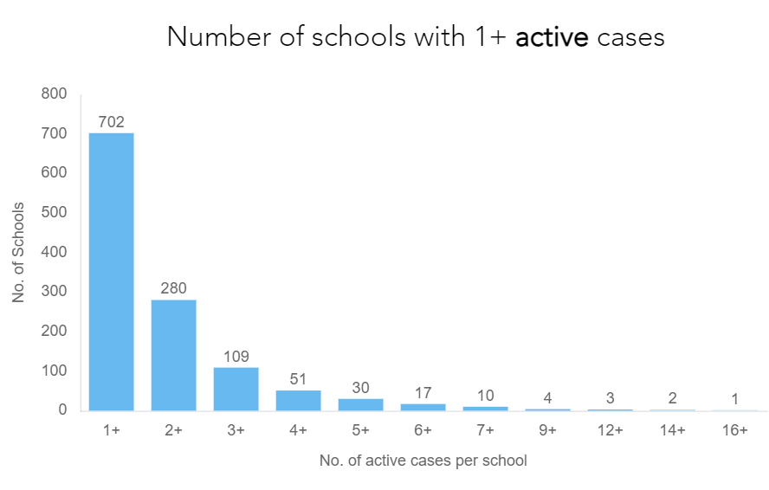
Notes:
One point to clarify is that while there are 702 schools where at least one child has been diagnosed with COVID, that doesn’t mean that that child caught covid at school, or that they even spread it to any other children who attend school with them.
This chart shows that of those 702 schools – most only have one or two cases of COVID.

Slide 35
Notes:
The number that I am finding more helpful to follow is the number of schools that are declared to have an outbreak.
That means that the 2nd cased in the school may have actually been caught while at school. That helps me understand how well the measures that have been put in place to prevent kids from catching COVID at school may be working.
The different public health units are publicly reporting the number of schools where an outbreak has been declared.
Here you can see the website for Toronto district school board.
This is from yesterday, it shows 8 schools out of 798 schools (1%) have an outbreak – that is 8 schools where at least one child may have caught covid at school.
339,000 students
(Today this number is 10).

Slide 36
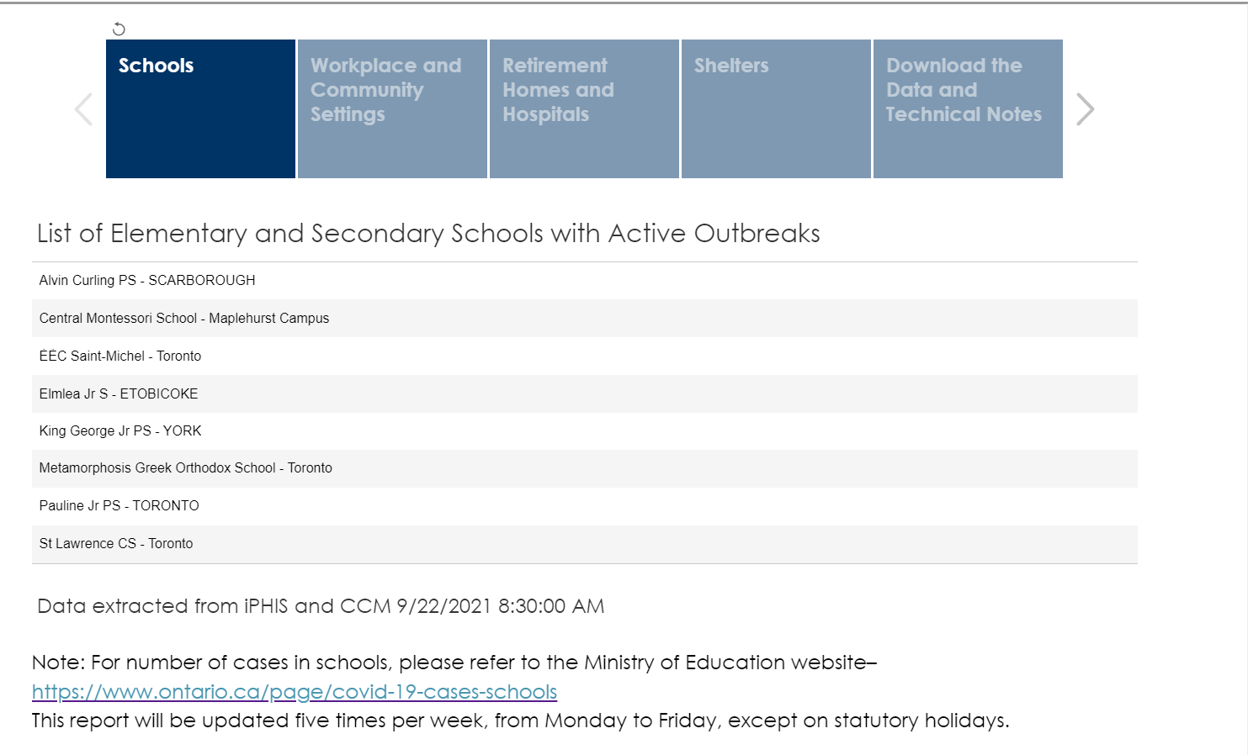
Notes:
And if you scroll down on this same page, they will list the names of the schools with the outbreak
Today – added St. Lawrence catholic school, and Tumpane public school

Slide 37
Summary points: COVID-19 and schools
Ontario.ca publicly reports the cases that are associated with schools
Currently approximately 1000 children attending schools in Ontario have been diagnosed with COVID-19 (out of 2 million children attending Ontario schools)
Came to school with COVID-19, but did they catch it from school?
Harder to say
Could reflect the amount of COVID that is in the community, caught it from someplace other than school (playdates, weddings, funerals, parties)
Toronto.ca reporting outbreaks in Toronto public and catholic schools – 10 at present
Parents should contact their school board and school for specific info about their school
Notes:
Data from around the world has shown teachers are not at higher risk of getting COVID at school vs. from other community exposures
Data from around the world showing that school COVID numbers reflect community transmission
Higher risk at playdates, weddings, funerals, parties

Slide 38
Summary points: COVID-19 and schools
Kids coming to school, some may have COVID-19, do the school measures work to stop it from spreading to other kids?
Ventilation, regular testing, screening, vaccination, masking, social distancing
Will get a better idea after 3-4 weeks of classes in session

Slide 39
In context of low community transmission, and high community vaccination rates
Children can safely return to school
If appropriate strategies are put into place.

Slide 40
Mitigation strategies
Physical distancing
Handwashing
Masks
Cohorting
Screening
Cleaning
Ventilation, Vaccination
Notes:
These are just some of the strategies – none are perfect, so multiple layers of mitigation helps

Slide 41
The balance
Attending school will mean an increased risk of getting COVID-19 (most children get mild disease)
Not attending school carries other negative effects on children and the family
So for each family to consider the risk of attending vs. the risk of not attending and decide what works best for them

Slide 42
Factors to consider in the balance
Community transmission rate
Age, vaccination status, and comorbidities of the child
Vulnerable contacts of the child?
The school’s plan

Slide 43
Question and Answer session
Image was from https://oliverands.com/community/blog/2013/11/questions-ask-me.html
Notes:
QUESTION DISTRIBUTION during Q&A: facilitation and interpretation by Pierre-Philippe and Sandra
Pierre-Philippe or Sandra – Medical
Chitra – IPAC
Ambuja – VAW shelter related practices

Slide 44
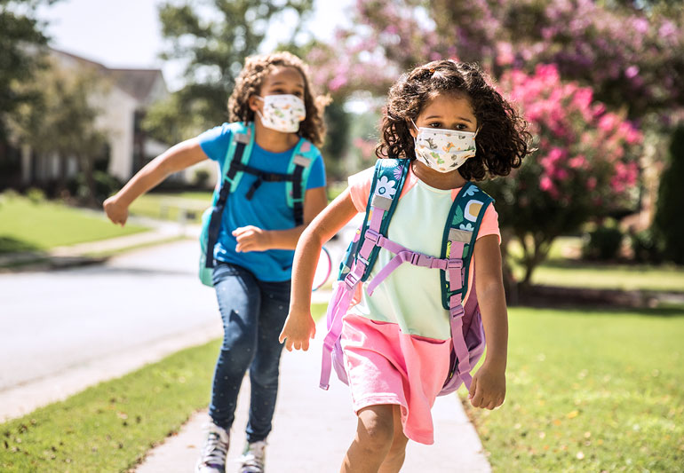
Thank-you
Notes:
Speakers: Pierre-Philippe and Sandra
We would like to thank everyone for joining us today, and we hope that the responses were what you were looking for.

