Slide 1
“Children Fight against COVID-19” October 15th, 2021
This presentation is made possible:
In collaboration with the Hospital for Sick Children (SickKids); the Ministry of Children, Community and Social Services (MCCSS); and the Violence against Women Sector (VAW)
Notes:
Chitra

Slide 2
Topics
Introduction
Case Scenarios – Overview
Scenario 1
Scenario 2
Scenario 3
Scenario 4
Other questions
Scenario 5
Notes:
Chitra

Slide 3
Speakers and Facilitators – SickKids & VAW
Laurie Streitenberger, Senior Manager Infection Prevention and Control [SickKids]
Anna Cotic, Occupational Hygienist [SickKids]
Alice Heisey, Team Lead Covid-19 Testing Center [SickKids]
Jasmine Aloysius, Youth Volunteer [Mary Ward CSS]
Ambuja Banerjee, VAW IPAC Champion [VAW Network]
Chitra Gnanasabesan, Senior Project Manager [SickKids]
Notes:
Chitra
Laurie Streitenberger is a Senior Manager, Infection Prevention and Control at SickKids. Her experience is in neonatal and pediatric infection prevention and control with a special interest in surgical site infections; and a pediatric IPAC consultant to community and international partners.
Anna Cotic is an Occupational Hygienist working in the Occupational Health and Safety Services department at SickKids hospital. Her focus is on staff safety including topics such as personal protective equipment.
Alice Heisley is a registered nurse working on several pediatric units at SickKids, and she’s presently seconded as the Team Lead for the Covid-19 Testing Center.
Jasmine Aloysius, Youth Volunteer: She goes to Mary Ward catholic secondary school, she’s in Grade 12, and is here with us to support us – thank-you Jasmine for helping us out today.
Ambuja Banerjee is a co-facilitator of this session along with me. She has years of clinical research experience, and currently works with the violence against women sector as an Infection Prevention and Control Champion.
I am Chitra Gnanasabesan, co-facilitator with Ambuja, and the Senior Project Manager with SickKids, seconded since last year to community support strategy during the waves of Covid-19.

Slide 4
Introduction – context worth noting
The guidance on COVID-19 is evolving as new information becomes available about the virus and the variants, and as COVID-19 rates change
The information in this presentation reflects what is presently known given up-to-date evidence, and is current as of October 2021
The information presented is to support the questions you asked
The speaker panel was hand-selected for their expertise, and specifically keeping you in mind
Notes:
Chitra
Hello everyone, thank you for attending the webinar. We hope to go over various questions that you have posed. As this PowerPoint provides solutions based on the Ministry guidance that exist presently, we would like to notify that these solutions may change as more research occurs, and as newer information becomes available about the COVID-19 virus and variants. Therefore the information presented today applies to what we are experiencing presently, and may require further updates at later dates of the pandemic.

Slide 5
Scenarios – overview
Why do we need to wear a mask, and how can we do hand washing well?
Why is it important to get vaccinated, and what are the side effects of vaccines in children?
Why is COVID-19 testing for children important?
Mom has COVID-like symptoms, how do I protect myself?
Don’t be afraid to let someone know that you have a runny nose
Notes:
Facilitator: Ambuja
Why do we need to wear a mask? Laurie & Anna
How can we do hand washing well and made easy, is there a rhyme to follow? Laurie & Anna
What are the symptoms of vaccines for children? Chitra (unless if anyone else is interested)
Why is it important to get vaccinated? Alice
Why is testing for children important (benefit, protection, care)? Alice
Don’t be afraid to let someone know that you have a runny nose (scared of cancelling an event, having CV-19, etc.) ???
Mom has COVID-like symptoms, how do I protect myself???

Slide 6
Scenario 1: Going to the grocery store with mom to pick up Halloween candies
It’s almost Halloween and it’s time to get some candies from the grocery store. I get to do trick or treating this year with my friends, that’s exciting. To go inside the store, I must first wear my mask, that’s what the sign on the door says.
Mom found a spot to park our car but far away from the store, I guess everyone is here to buy Halloween candies and decorations. We came to the front of the store, and I realized that I forgot my mask in the car. Oh no, I have to walk all the way back to the car to get it.
Why can’t I go into the store without a mask, it’ll be a quick visit?
https://www.dreamstime.com/cartoon-people-choosing-buying-fresh-products-grocery-store-vector-flat-illustration-colorful-man-woman-shopper-supermarket-image182423630
Notes:
Reading the scenario: Jasmine
Speakers: Laurie and Anna

Slide 7
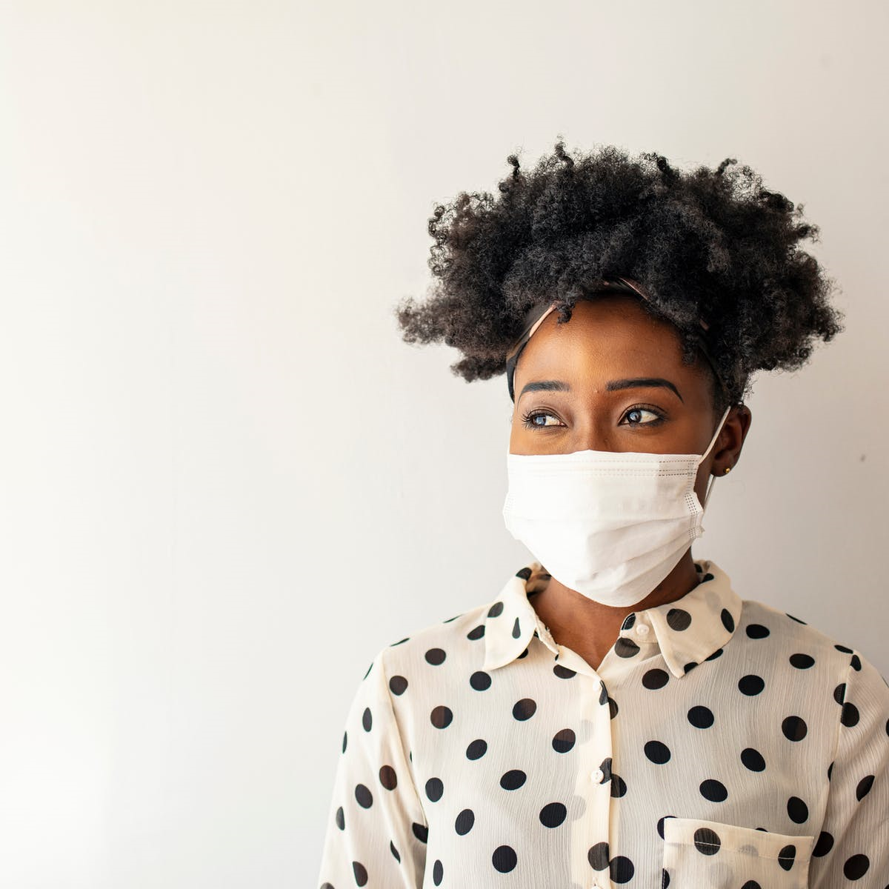
Why do we need to wear a mask?
https://www.mayoclinichealthsystem.org/hometown-health/speaking-of-health/debunked-myths-about-face-masks
Notes:
Reading the question: Jasmine

Slide 8
Let’s think about masking …
COVID is transmitted by germs coming from our respiratory tract that can be spread to others by such activities as talking, laughing, singing, coughing, or sneezing.
Wearing a mask helps to keep these germs to ourselves
Mask is fitting properly (nose and mouth covered)
Maintain physical distance from others in the store
Don’t remove your mask when speaking with anyone – if it’s necessary because they can’t understand you, maintain at least 2m from anyone while your mask is off
Clean your hands with hand sanitizer when you leave the store (if they don’t supply it, use yours)
Notes:
Speakers: Laurie and Anna

Slide 9
Why clean our hands when leaving the store?
It’s easy to clean hands
https://www.treatedwell.com/washing-your-hands-could-save-your-life/
Notes:
Reading the question: Jasmine

Slide 10
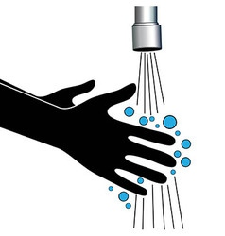
Let’s think about washing hands …
Clean your hands with hand sanitizer when you leave the store (if they don’t supply it, use yours)
Easiest is hand sanitizer – you can do it anywhere, but your hands need to look clean for it to work best!
Cleaning your hands involves careful attention to all areas of your hand. It usually takes 15-20 seconds to cover all areas effectively.
Singing or humming “ABCs”, “Happy Birthday”, “Twinkle, twinkle little star” takes about 15-20 seconds so these songs are often recommended
https://www.vectorstock.com/royalty-free-vectors/clean-hands-vectors
https://www.canstockphoto.com/clean-hands-icon-82196539.html
Notes:
Speakers: Laurie and Anna

Slide 11
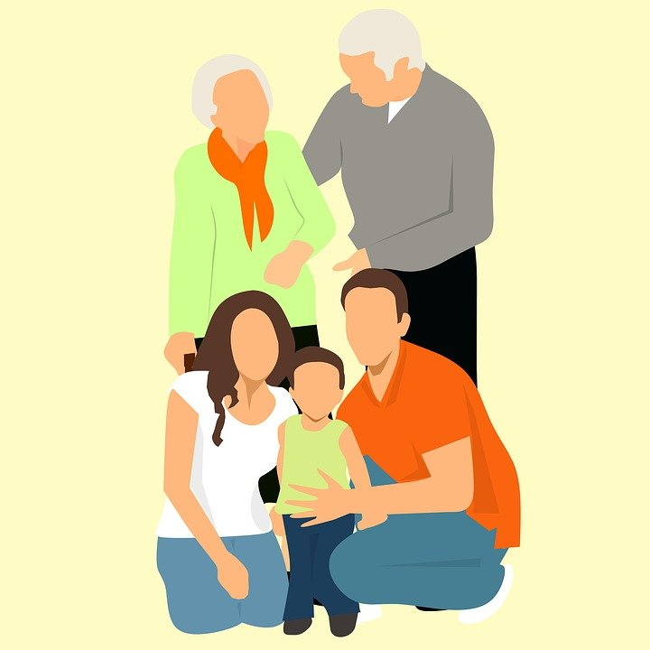
Scenario 2: Visiting grandparents at their house
We usually visit grandpa and grandma on weekends. My parents told me that since we have received our vaccination, it should be safer to go places and to visit them.
I don’t understand why vaccination keeps people safe.
Notes:
Reading the scenario: Jasmine

Slide 12
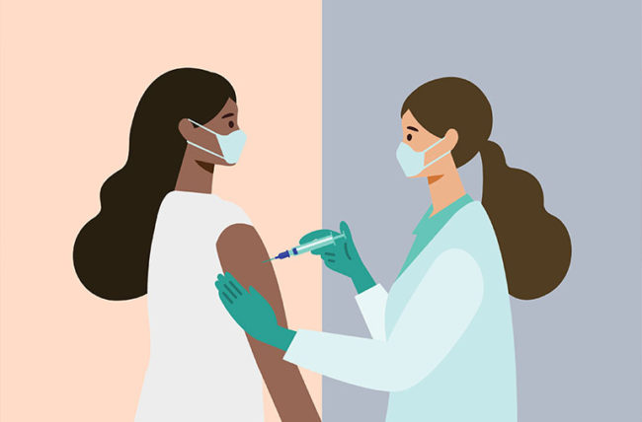
Why is it important to get vaccinated for COVID-19?
Notes:
Reading the question: Jasmine

Slide 13
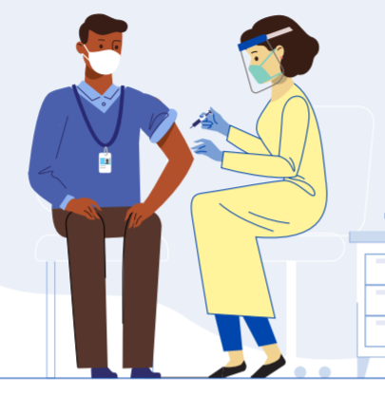
Let’s think about vaccination …
Vaccines are safe, effective and the best way to protect yourself from COVID-19
Vaccines help stop the spread of COVID-19 and allow children and families to safely resume normal activities
Vaccines help your body build immunity to the virus so if you do get infected you can fight the virus off more easily
Decrease your risk of developing COVID-19 and make symptoms, if any, much more mild
Less likely to face serious illness, hospitalization or death
Benefits of the vaccine far outweigh the risks
Notes:
Speaker: Alice
There are mild risks associated with the vaccine but there are many more serious risks associated with getting infected from COVID-19 such as long-term complications like respiratory, heart or neurological issues, among others
Vaccines are safe, effective and the best way to stay protected from COVID-1. They are an important tool to help to stop the spread of the virus and allow students and families to safely resume normal activities.
COVID-19covid 19 vaccines do not cause a coronavirus infection. They help build up immunity to the virus, so that your body will fight it off more easily. This can reduce the risk of developing COVID-19covid 19 or make the symptoms milder if you do get it.
Health Canada has approved the use of the Pfizer-BioNTech vaccine for youth born in 2009 or earlier. This means that they have determined that this vaccine:
is safe, effective and manufactured to the highest quality
prepares your immune system to fight against COVID-19covid 19
shows a strong antibody response for this age group
The benefits of the COVID-19 vaccine far outweigh the risk of getting a COVID-19 infection
If you are ever exposed to the COVID-19 virus, being vaccinated will allow your immune system to fight the infection
You are extremely less likely to get seriously ill, be hospitalized or die from the virus if you are vaccinated
There are mild risks associated with the vaccine but there are many more serious risks associated with getting infected from COVID-19 such as long-term complications
These include respiratory, heart, and neurological issues, among others

Slide 14
What are the side effects of vaccine in children?
The COVID-19 vaccine produces an immune response, which can sometimes cause the following side effects:
Pain, redness, slight swelling at the injection site
Flu-like symptoms, fever, muscle aches, joint pain, headache
Side effects can last for 1-2 days post vaccination
Although some of the side effects are similar to COVID-19 symptoms, you CANNOT get COVID-19 from the vaccine
A vaccine side effect you may have heard about on social media is myocarditis
Myocarditis is a very rare side effect (0.00005% in 12-17 age group) of the vaccine, and most cases have a rapid resolution of symptoms (Public Health Ontario, 2021)
Notes:
Speaker: Alice

Slide 15
How old do you have to be to get vaccinated?
Any child that is born in 2009 or earlier
You must be 11 years old turning 12 years old this year
Trials underway to approve the vaccine for children 6-11 years old
This age group may be able to be vaccinated as early as December
The vaccine approved for children is the Pfizer-BioNTech vaccine, commonly known as “Pfizer”
As of August 9, approximately 78 per cent of youth ages 12 to 17 have initiated vaccination, with approximately 62 per cent having now received both doses (City of Toronto, 2021).
Notes:
Speaker: Alice
City of Toronto (2021). Toronto Public Health continues to expand youth COVID-19 vaccination opportunities. https://www.toronto.ca/news/toronto-public-health-continues-to-expand-youth-covid-19-vaccination-opportunities/
Ontario (2021). Covid 19- Vaccines for Youth. https://covid-19.ontario.ca/covid-19-vaccines-youth?gclid=CjwKCAjwkvWKBhB4EiwA-GHjFnCfyzWzvzK1rOq8pj13LmDxRWeOcdJc0fW8kfpFA68Ev9H6nq6VLxoCtlMQAvD_BwE&gclsrc=aw.ds
Public Health Ontario (2021). Adverse Events Following Immunization (AEFIs) for COVID-19 in Ontario: December 13, 2020 to September 26, 2021. https://www.publichealthontario.ca/-/media/documents/ncov/epi/covid-19-aefi-report.pdf?sc_lang=en

Slide 16
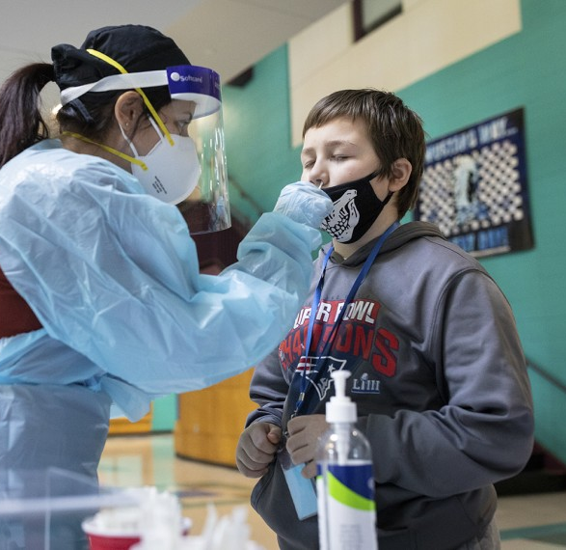
Scenario 3: My class is going through COVID-19 testing
My teacher told us that our class is going through COVID-19 testing tomorrow. The SickKids Hospital is coming to our school to test everyone in my class. I heard that someone in our class has flu-like symptoms, maybe that’s why SickKids is coming.
I don’t have flu-like symptoms but still need to get tested for COVID-19 also. I’m not sure why I should get tested.
https://www.edweek.org/leadership/should-schools-test-students-and-staff-for-covid-19/2021/03
Notes:
Reading the scenario: Jasmine

Slide 17
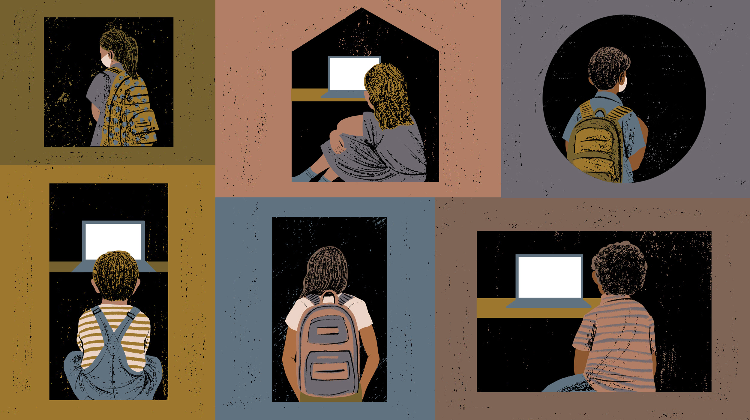
Why is it important for children to get tested for COVID-19?
Notes:
Reading the question: Jasmine

Slide 18
Why is it important for children to get tested for COVID-19?
Protect yourself, your family, friends and community, especially the most vulnerable
You may have mild or no symptoms of COVID-19 and still be infected or spread the virus to others, need to know if you are positive so you can isolate
Monitor yourself for symptoms in case you need medical care
Set a good example for your peers and those around you
Notes:
Speaker: Alice

Slide 19
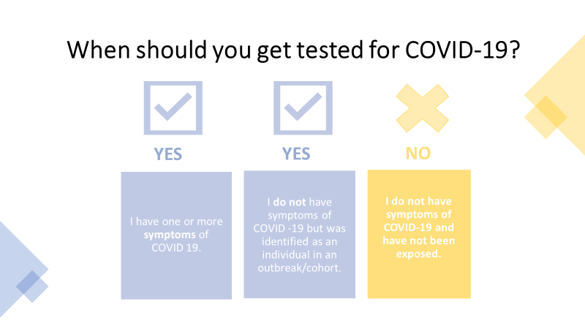
Notes:
Speaker: Alice

Slide 20
What kind of COVID-19 Testing is there?
Nasopharyngeal swab
Deep nose swab
Not painful but some kids find it uncomfortable, it may cause
your eyes to water or you may have the urge to sneeze/cough
Saliva
Spit in a container
Anterior Nare/ Throat Swab
Swab goes inside lower part of nose and in mouth
Notes:
Speaker: Alice

Slide 21
GAME 1: Quiz Time!
https://www.quiz-maker.com/QTN588J5H
Notes:
Facilitator: Ambuja
Time: 5 minutes
Now that we’ve gone through 3 different scenarios, let’s play a game to see how much you remember.
Remember, there’s a cool prize for every correct answer
Type in your answer as soon as you know in the chat box
The first person to give the correct answer in the chat box gets the prize
Is everyone ready….

Slide 22
Case Study 4: My mom doesn’t look well
https://www.vox.com/science-and-health/2017/6/26/15872734/postnatal-care-america
I noticed my mom is not feeling well with the sniffles this morning. She also started coughing and looks more tired and worried than usual.
I think maybe it’s contagious and I can catch whatever it is that she has. We live in a shelter sharing a room. I hope she doesn’t have COVID-19.
HOW DO I PROTECT MYSELF FROM GETTING WHAT SHE HAS?
Notes:
Reading the scenario: Jasmine

Slide 23
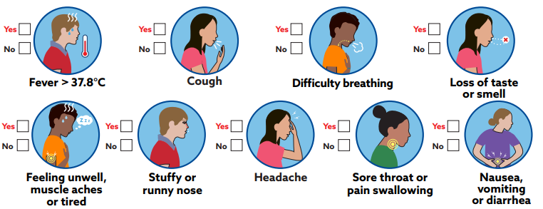
Let's think about COVID-19 symptoms ...
These are all the symptoms that presents with COVID-19 infection
The flu season is here and some respiratory symptoms are shared by the flu virus also
Not all these symptoms may be present with your mom
The only positive way to know if mom has COVID-19 infection is by doing the COVID-19 test
https://www.toronto.ca/wp-content/uploads/2020/08/94e5-Survey-poster-Schools.pdf
https://covid-19.ontario.ca/self-assessment/
Notes:
Speakers: Laurie and Anna
1.) Should she get tested for Covid-19 because of these symptoms?
Make an appointment at an Assessment Centre near you to get tested.
Mom drives to the assessment centre if she can. Do not use public transit. Ask for a ride, or use a taxi or ride share. She wears a mask, sits in the back seat, and keeps the windows open.
2.) Is it ok for her to be around other people still?
For safety precautions continue to wear your PPE (masks, gloves, etc.) and maintain social distance from other people
Wipe down any surfaces that your child or you have touched (toys, door handles, toilet, etc.) with a disinfectant.
Continue to use hand sanitizers and practice hand hygiene.
Continue to isolate in the room assigned for you and your child until symptoms decrease before being around people.
3.) Aside from the sniffles and cough they seem to be feeling ok, do they need to see a doctor?
Monitor their symptoms (coughs and sniffles) and look out for other symptoms of COVID-19 (fever, tiredness, dry coughs, shortness of breath, etc.).
People who are experiencing at least one of the symptoms of COVID-19 and have any of the following signs of severe illness:
Shortness of breath
Chest pain
Weakness
Lethargy or drowsiness
Dizziness

Slide 24
If “YES” to any symptom, now what? ...
Notes:
Speakers: Laurie and Anna
1.) Should she get tested for Covid-19 because of these symptoms?
Make an appointment at an Assessment Centre near you to get tested.
Mom drives to the assessment centre if she can. Do not use public transit. Ask for a ride, or use a taxi or ride share. She wears a mask, sits in the back seat, and keeps the windows open.
2.) Is it ok for her to be around other people still?
For safety precautions continue to wear your PPE (masks, gloves, etc.) and maintain social distance from other people
Wipe down any surfaces that your child or you have touched (toys, door handles, toilet, etc.) with a disinfectant.
Continue to use hand sanitizers and practice hand hygiene.
Continue to isolate in the room assigned for you and your child until symptoms decrease before being around people.
3.) Aside from the sniffles and cough they seem to be feeling ok, do they need to see a doctor?
Monitor their symptoms (coughs and sniffles) and look out for other symptoms of COVID-19 (fever, tiredness, dry coughs, shortness of breath, etc.).
People who are experiencing at least one of the symptoms of COVID-19 and have any of the following signs of severe illness:
Shortness of breath
Chest pain
Weakness
Lethargy or drowsiness
Dizziness

Slide 25
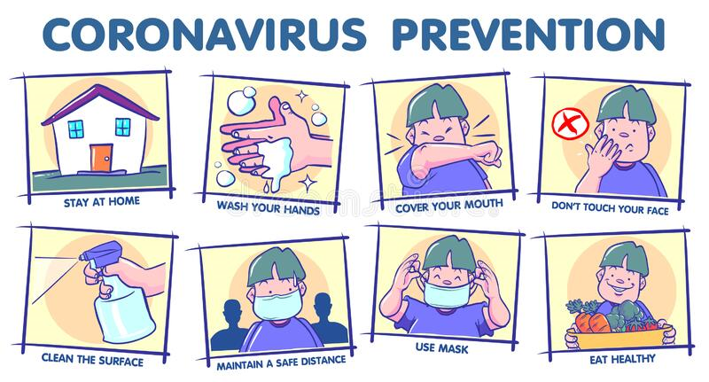
How do I protect myself at the shelter?
Wear a well-fitted mask, and mom wears a mask also
Keep 2m away from mom who is self-isolating
Wash hands often
Do not touch your eyes or face without washing hands first
Eat your food in a well-ventilated area, and at least 2m away from mom
https://www.dreamstime.com/coronavirus-prevention-tips-quarantine-covid-instruction-outside-street-people-society-safety-rules-pandemic-image184504430
Notes:
Speakers: Laurie and Anna

Slide 26
Case Study 5: We are going on a family trip
I’m so excited this morning, my family and I are going on a trip. It’s been a long time since we had fun together as a family.
Oh no, I woke up with a runny nose, but I don’t have any other symptoms. I’m scared to tell anyone that I have a runny nose because our trip will get cancelled all because of me.
But I know that the right thing to do is let someone know.
https://www.bigstockphoto.com/image-371687293/stock-photo-happy-same-sex-family-going-on-a-car-trip-around-the-country-lesbian-couple-with-son-and-dog-are-lo
Notes:
Reading the scenario: Jasmine

Slide 27
Let’s think about this situation …
It’s important to tell your mom about the runny nose
Being honest helps protect so many people around you
Check yourself for other symptoms – do you have any other symptom (fever, cough, headache, etc.)?
Can you keep a mask on your face or is your nose blocked?
Maintain 2m away from others
Wash hands after using tissue paper
Discard used tissue in trash can and wash hands afterwards
Notes:
Speakers: Laurie and Anna

Slide 28
GAME 2: Let’s test your knowledge!
http://www.quiz-maker.com/QTN588J5H
Notes:
Facilitator: Ambuja
Time: 5 minutes
Now that we’ve gone through 3 different scenarios, let’s play a game to see how much you remember.
Remember, there’s a cool prize for every correct answer
Type in your answer as soon as you know in the chat box
The first person to give the correct answer in the chat box gets the prize
Is everyone ready….

Slide 29
Other Questions
Notes:
Facilitators: Ambuja and Chitra
Image was from https://oliverands.com/community/blog/2013/11/questions-ask-me.html

