Slide 1
COVID-19 Interim Guidance: Omicron Surge Management of Critical Staffing Shortages in Highest Risk Settings
Notes:
Guidance was released on January 12th

Slide 2
Purpose
provide a framework for employers and operators of certain highest risk settings to use when considering early return to work of staff who are otherwise not eligible for early return to work as mitigation to critical staffing shortages, and without approval of the local public health unit
Notes:
The purpose of the document is to provide a framework and some direction towards addressing the staff shortages that many agencies are facing due to the current situation with the pandemic. This provide guidance around how to determine whetehr or not a staff should consider early return to work to mitigate the staffing shortages.

Slide 3
Current Guidance for Cases and Close contacts
Cases and close contacts who work in highest risk settings are required to not attend work for 10 days from symptom onset/positive test or last exposure to a case
Cases (positive test or symptoms-based) do not require a test to return to work after 10 days isolation.
Close contacts with a single negative PCR test collected on/after day 7 after last exposure OR two negative RATs collected 24 hours apart on day 6 and 7 after last exposure can return to work.
Close contacts in highest-risk settings who develop any symptoms of COVID-19 should self- isolate and be tested immediately.
At this time of high community transmission, these requirements may lead to staffing shortages impacting patient/resident care in these highest-risk settings
Notes:
So the current guidance for cases and close contacts is presented here which is as per the provincial standard, you may have heard something different due to varying local public health policies
But as per the pronviincial standards, the isolation period is 10 days and do not reuqire a negative test to return to work
Close contacts of those in highest risk settings should also self isolate and test themselves immediately
Close contacts with pcr test on day 7 or rat on day 6 and 7 presenting with negative tests on all ests can return to work on that day 7 mark

Slide 4
Guidance for Early Return to Work
Cases and close contacts who work in highest risk settings are required to not attend work for 10 days from symptom onset/positive test or last exposure to a case
Cases (positive test or symptoms-based) do not require a test to return to work after 10 days isolation.
Close contacts with a single negative PCR test collected on/after day 7 after last exposure OR two negative RATs collected 24 hours apart on day 6 and 7 after last exposure can return to work.
Close contacts in highest-risk settings who develop any symptoms of COVID-19 should self- isolate and be tested immediately.
At this time of high community transmission, these requirements may lead to staffing shortages impacting patient/resident care in these highest-risk settings
Notes:
As per the guidance, depending on the risk of staff shortages or other shortages at the organization which would impede our ability to provide our services, there are changes that can be applied to determine if staff should be able to return to work sooner or not. This provides a brief overview of what is presented in the guidance document for those who are mainly testing positive or have had positive exposure
The risk here is not for the setting but rather the staff shrotages

Slide 5
Risk Assessment
Notes:
This is a table that was created by SafeHaven that can be used to perform a risk assessment at your organization and to determine where your organization falls in terms of being either low, moderate or high risk as it would better inform the early return to work policy. It is helpful to assess where you fall on this spectrum for various aspects such as services provided, the sites itself, supplies and equipment available and to determine the risk to clients that the current circumstances are presenting as staff are in self-islation. Depending on where your organization is falling, that is how to best gauge which early return to work policy you would like to employ at that time. Please keep in mind that your organization may be at a low risk one day, but moderate risk at another time and so this is a rather fluid plan and that staff are made aware of this

Slide 6
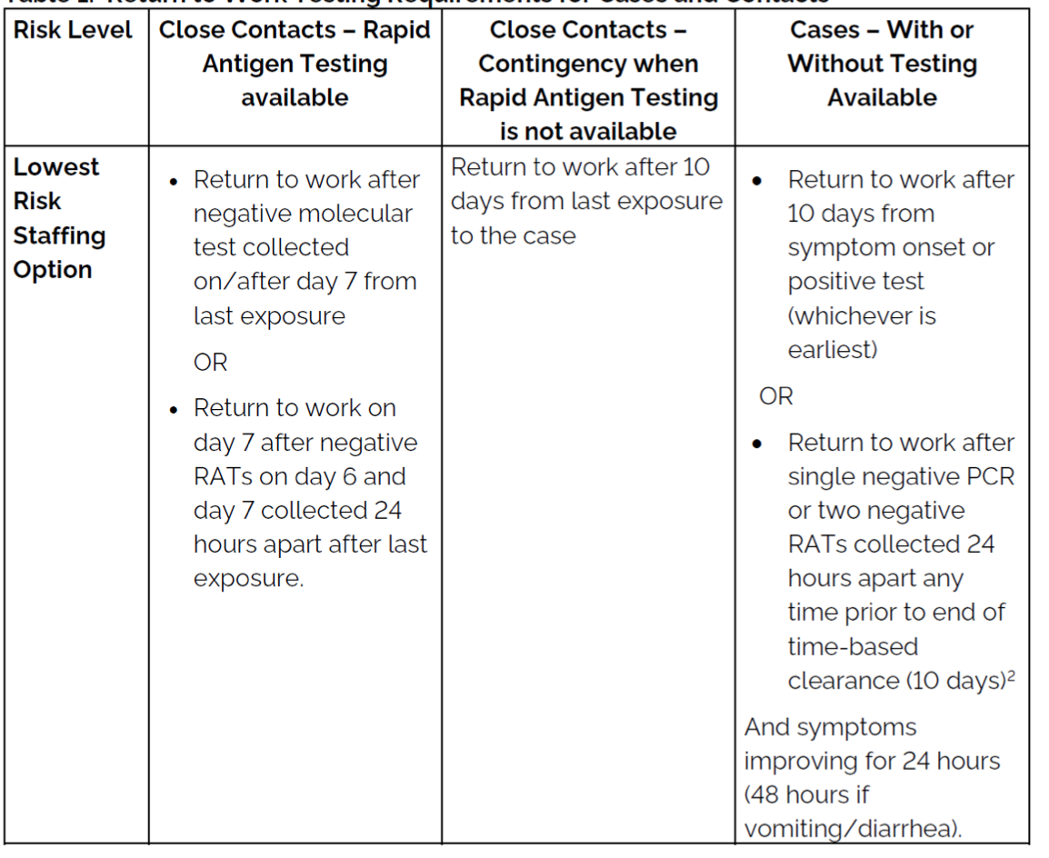
Low Risk

Slide 7
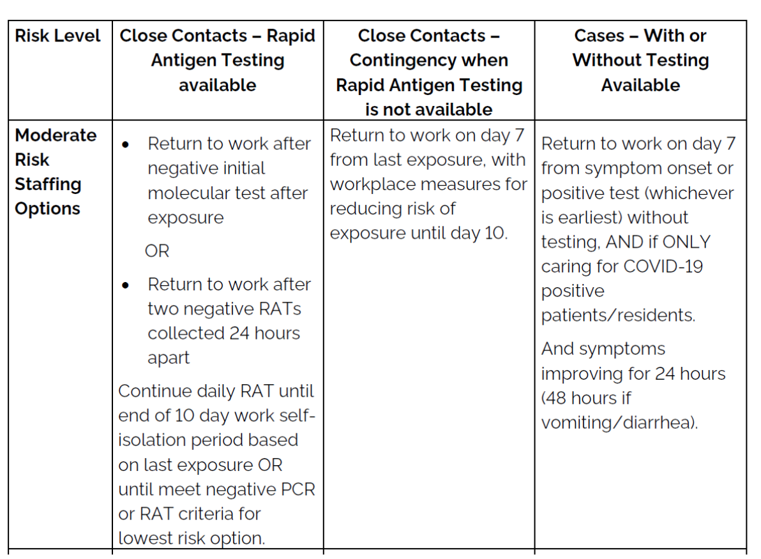
Moderate Risk

Slide 8
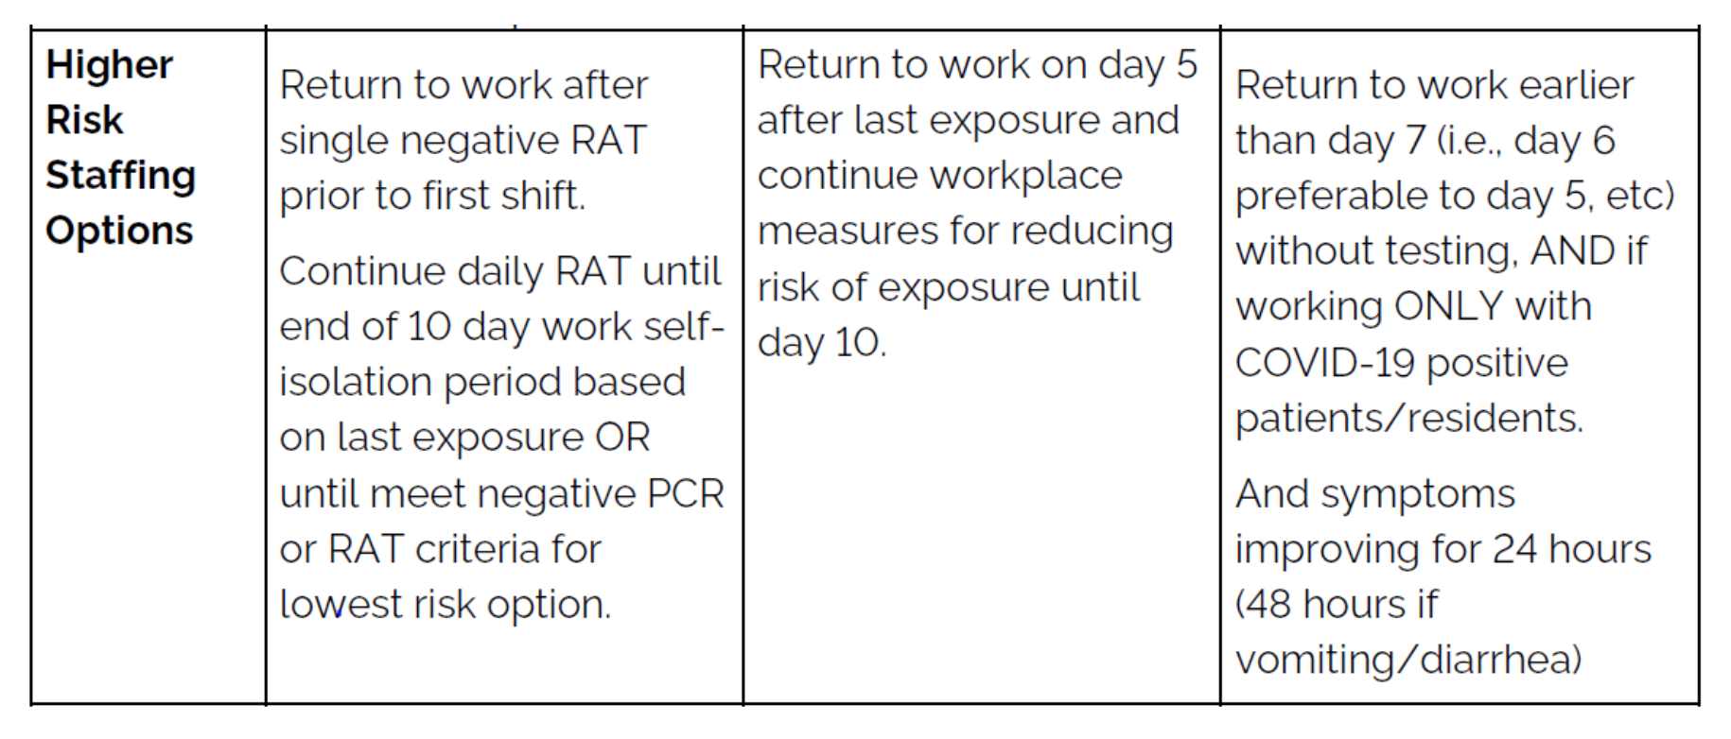
High Risk

