Slide 1
Rapid Antigen Test Training

Slide 2
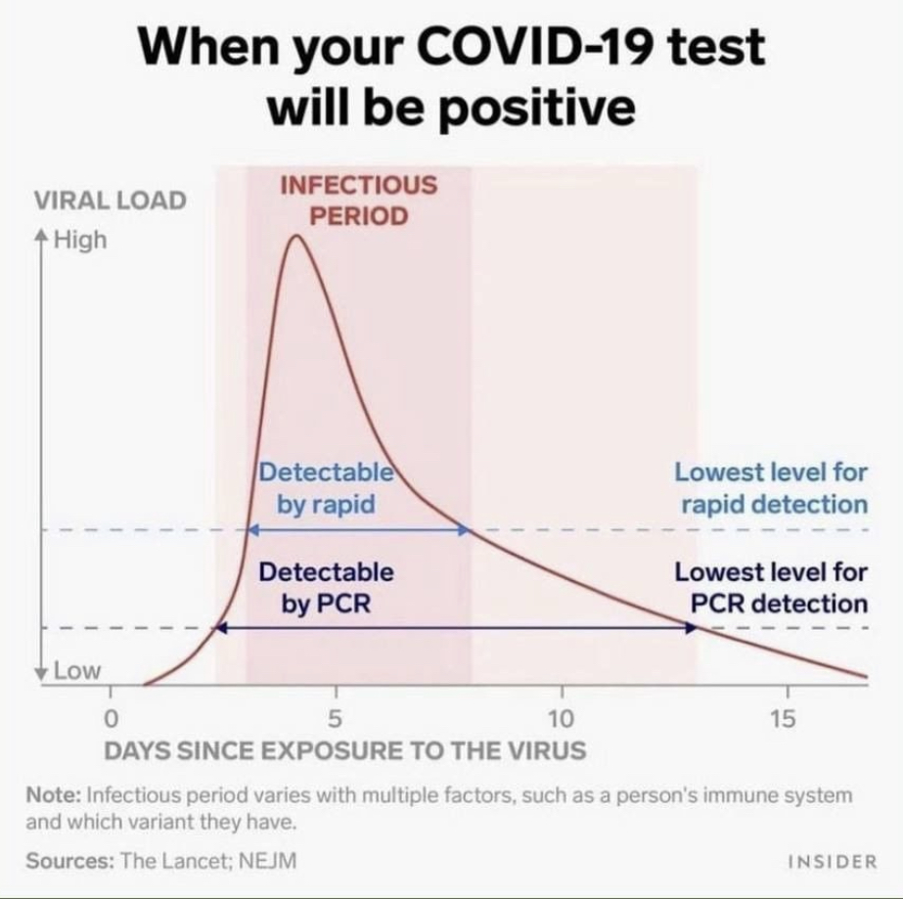
^{Rapid Antigen Tests}
Purpose is to act as an enhanced screening measure and to detect SARS-CoV-2 antigen
Eligibility
Asymptomatic individuals
Individuals who have not tested positive for COVID-19 in the past 30 days

Slide 3
PanbioTM
• 25 test devices • 25 extraction tubes • 25 tube caps • 25 sterilized nasopharyngeal (NP) swabs for specimen collection
• 1 Buffer (1 x 9ml/bottle) • 1 Positive control swab • 1 Negative control swab • 1 tube rack • 1 Quick reference guide • 1 Instructions for use

Slide 4
PanbioTM

Slide 5
PanbioTM – Step 1: Set up your station
• Clean, flat surface/table • Timers • PanbioTM kits (test device, extraction tube, buffer solution, tube cap, tube rack, nasal swab) • PPE (If performing on someone else, you need gloves, mask, face shield and gown) • Biohazard waste bin • Hand sanitizer and disinfectant wipes

Slide 6
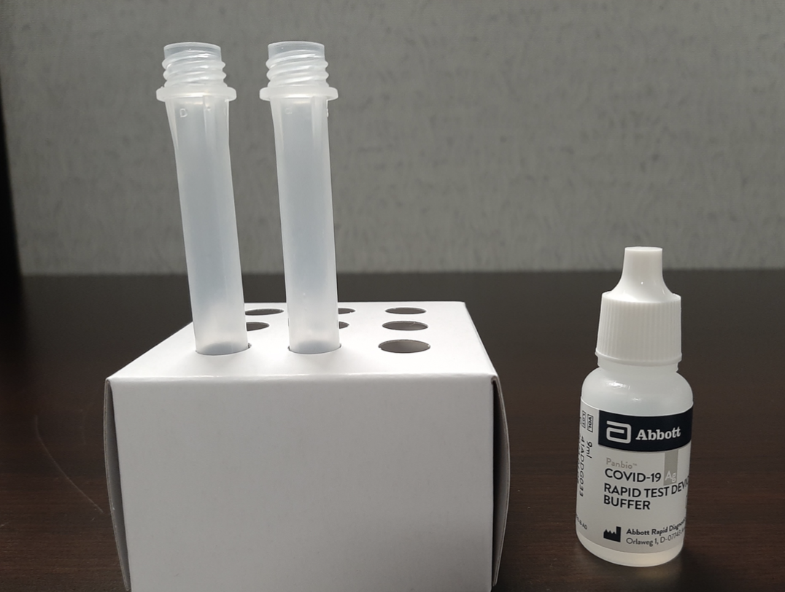
PanbioTM – Step 2: Prepare your testing gear

Slide 7
PanbioTM – Step 3: Add buffer solution to tube

Slide 8
PanbioTM – Step 4: Complete the swab

Slide 9
PanbioTM – Step 5:Add swab to the tubes

Slide 10
PanbioTM – Step 6: Add sample to test device

Slide 11
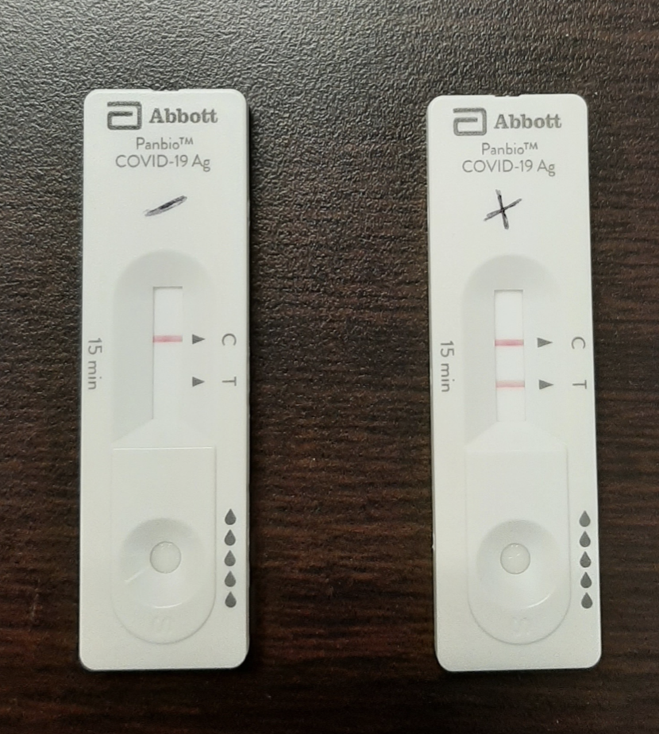
PanbioTM – Step 7: Wait for test to develop and read results

Slide 12
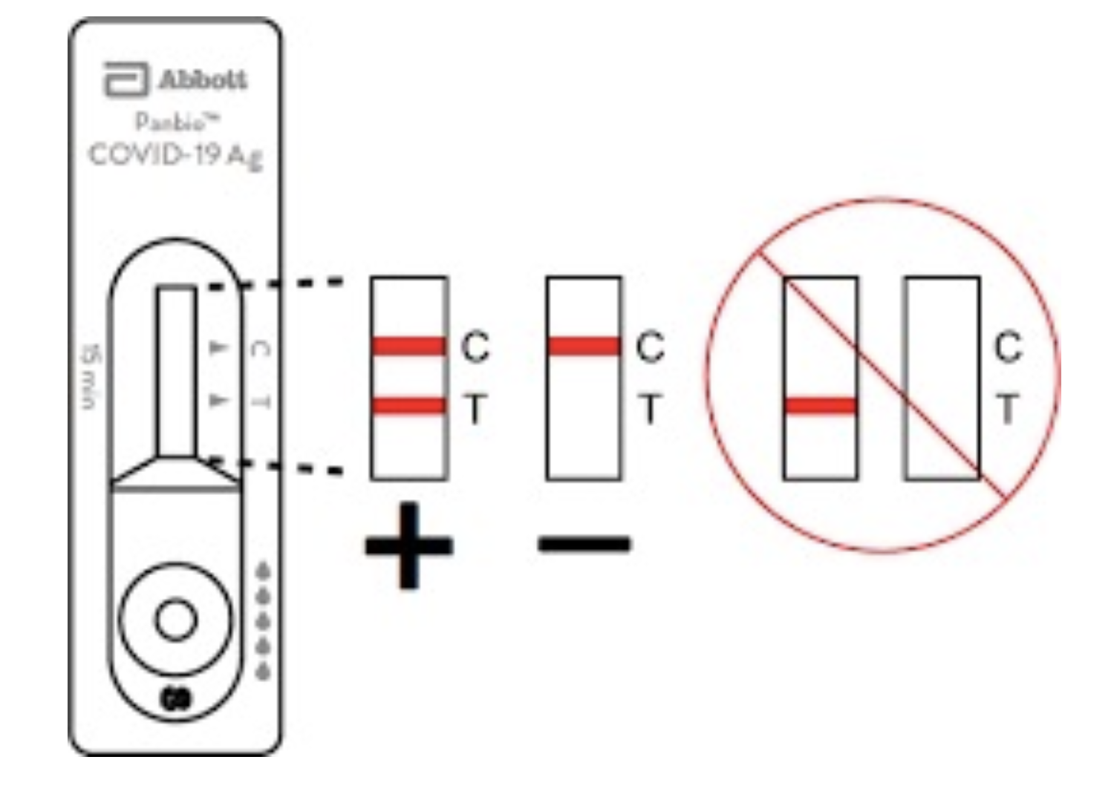
PanbioTM – Step 7: Wait for test to develop and read results

Slide 13
PanbioTM – Step 8: Clean station with disinfectant wipes and dispose of waste appropriately

Slide 14
PanbioTM Quick Video
https://www.youtube.com/watch?v=FH2N9LAKIKg

Slide 15
BD Veritor
• 30 test devices • 30 pre-filled reagent tubes • 30 sterilized nasal swabs for specimen collection
• 1 Positive control swab • 1 Negative control swab • 1 tube rack • 1 Quick reference guide • 1 Instructions for use • Nasal sample quick reference instructions

Slide 16
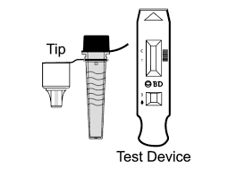
BD Veritor – Step 1: Set up your station
Pre-filled extraction reagent tube
Test Device
Nasal Swab
Tube Rack
Timer
Bin
Hand sanitizer and disinfectant wipes
PPE
Clean and flat surface

Slide 17
BD Veritor – Step 2: Prepare your testing gear
Place your tube in the tube rack and loosen the cap on the top
Ensure that your test device is ready for use out of its packaging and swab is ready

Slide 18
BD Veritor – Step 3: Complete the swab

Slide 19
BD Veritor – Step 4: Add swab to the tubes

Slide 20
BD Veritor – Step 4: Add sample to test device and analyze results

Slide 21
BD Veritor Quick Video
https://www.youtube.com/watch?v=_65MZIt48cU

Slide 22
QuickVue – Step 1: Set up your station
Box Contents vary depending on the pack that is bought
Station:
Tubes
Tube Rack
Test strips
Swab
Timer
PPE
Bin
Hand Sanitizer and disinfectant wipes
Clean and flat surface

Slide 23
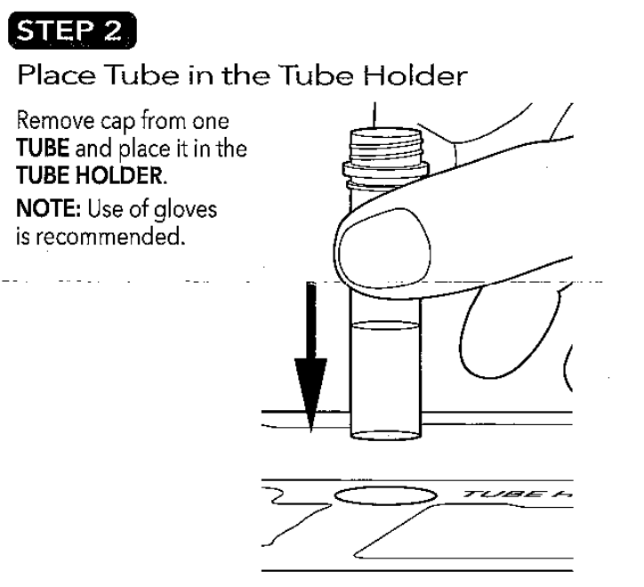
QuickVue – Step 2: Preparing testing gear

Slide 24
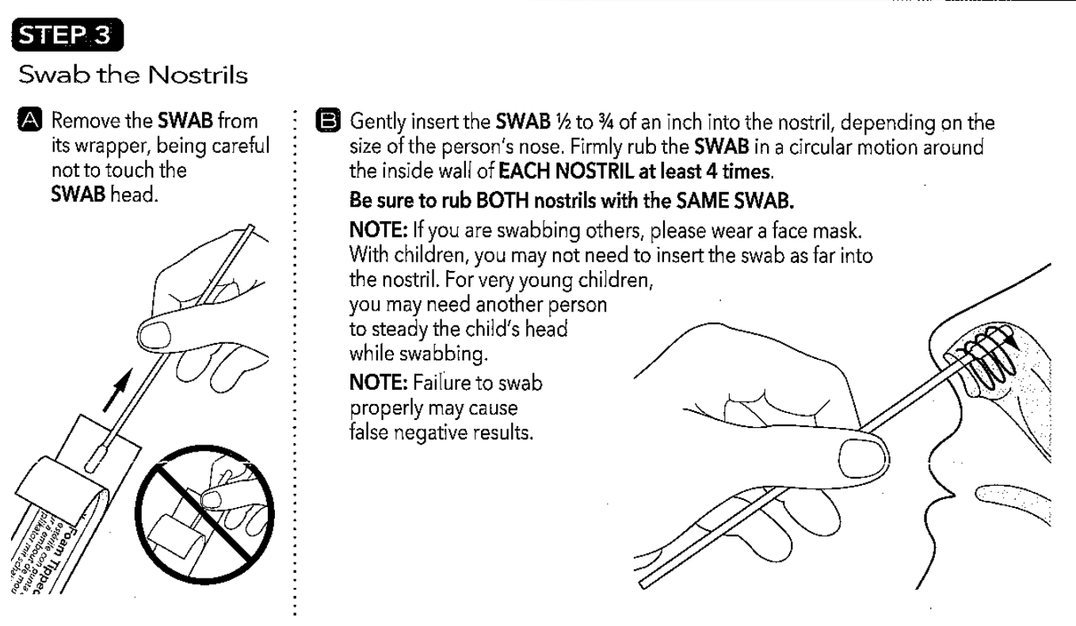
QuickVue – Step 3: Complete the swab

Slide 25
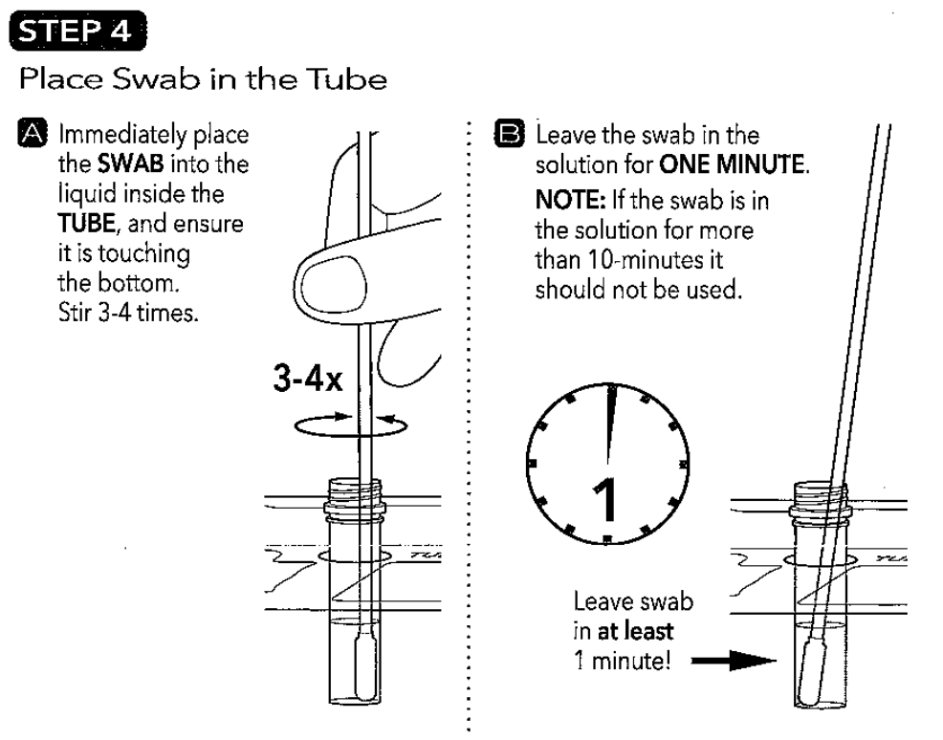
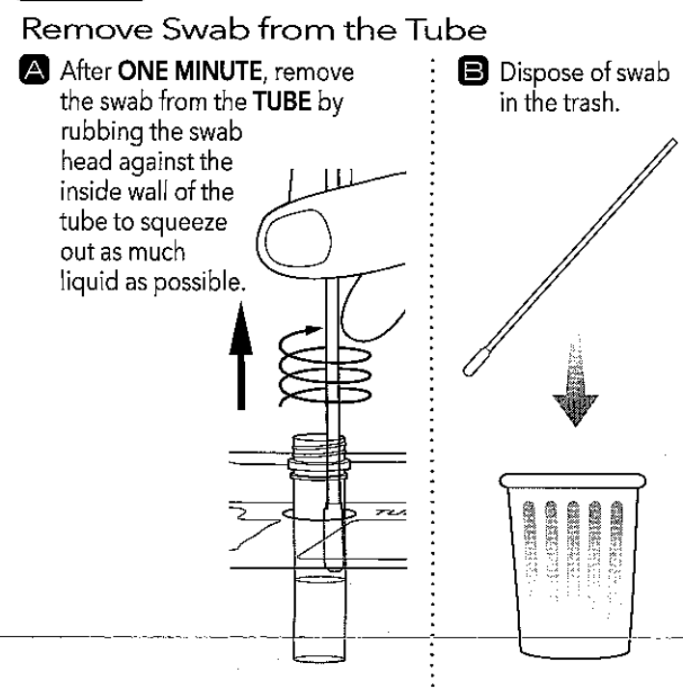
QuickVue – Step 4: Prepare sample for analysis

Slide 26
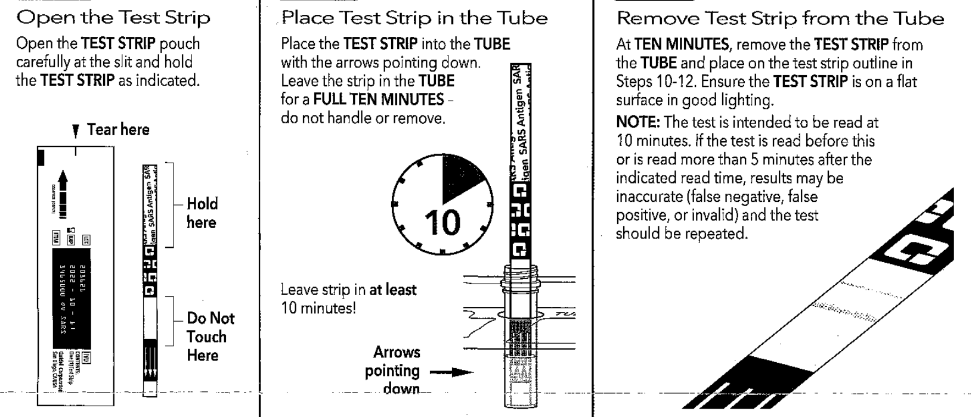
QuickVue – Step 5: Place Test strip in sample

Slide 27
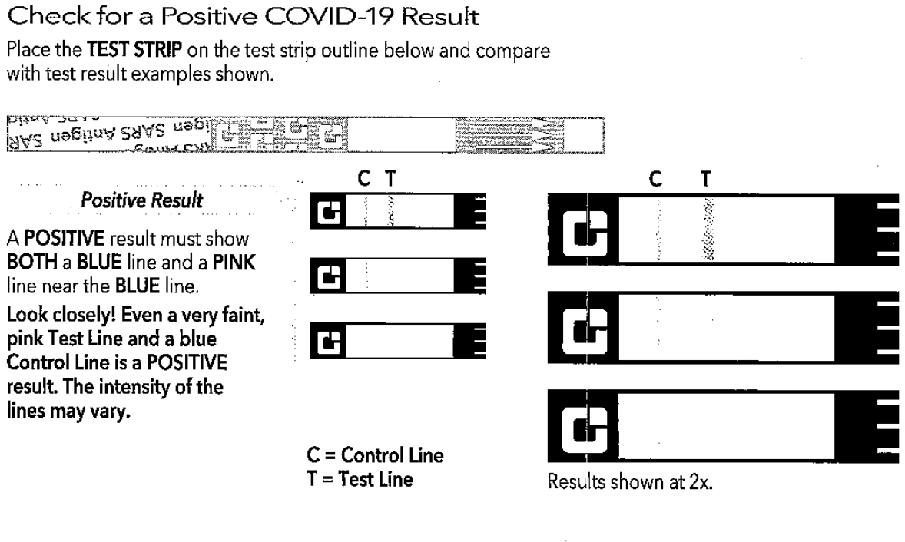
QuickVue – Step 6: Analyze results

Slide 28
QuickVue – Quick Video
https://www.youtube.com/watch?v=VifHP5M14UI

